Slide 1
Public finance support need for e-business tools
implementation within the micro enterprises
in Pelagonija region
Dr Anastas Djurovski

Slide 2
Production Sector | n=36 |  | Services sector | n= 95
In which area do you use digitalization |  |  | In which area do you use digitalization
General Management | 36 | 100.00% | General Management | 95 | 100.00%
Finance | 25 | 69.44% | Finance | 82 | 86.32%
Production | 15 | 41.67% | Service product preparation | 95 | 100.00%
Marketing | 25 | 69.44% | Marketing | 65 | 68.42%
Production |  |  | Services

Slide 3
Which tools do you use mostly? |  |  | Which tools do you use mostly?
Production |  |  | Services
General Management |  |  | General Management |  |  | Average | Management
Phone apps | 36 | 100.00% | Phone apps | 95 | 100.00% | 100.00% | 49.47%
E mail | 31 | 86.11% | E mail | 95 | 100.00% | 93.06%
Special software (company tailored) | 4 | 11.11% | Special software (company tailored) | 15 | 15.79% | 13.45%
Platforms | 5 | 13.89% | Platforms | 22 | 23.16% | 18.52%
Digital markets | 10 | 27.78% | Digital markets | 16 | 16.84% | 22.31%
 |  | 47.78% |  |  | 51.16%
Finance |  |  | Finance |  |  |  | Finance
Accounting software | 36 | 100.00% | Accounting software | 95 | 100.00% | 100.00% | 67.45%
Bank correspondence | 32 | 88.89% | Bank correspondence | 95 | 100.00% | 94.44%
Money market | 0 | 0.00% | Money market | 15 | 15.79% | 7.89%
 |  | 62.96% |  |  | 71.93%
Production |  |  | Service product preparation |  |  |  | Products
Computerized machines | 5 | 13.89% | Computerized machines | 28 | 29.47% | 21.68% | 14.53%
Automated software | 1 | 2.78% | Automated software | 39 | 41.05% | 21.92%
Robots | 0 | 0.00% | Robots | 0 | 0.00% | 0.00%
 |  | 5.56% |  |  | 23.51%
Marketing |  |  | Marketing |  |  |  | Marketing
Web sites | 28 | 77.78% | Web sites | 63 | 66.32% | 72.05% | 61.98%
Free advertizing tools | 36 | 100.00% | Free advertizing tools | 71 | 74.74% | 87.37%
Paid advertizing tools | 10 | 27.78% | Paid advertizing tools | 24 | 25.26% | 26.52%
 |  | 68.52% |  |  | 55.44%

Slide 8
Average digitalization in Macedonia =48.35%
Digitalization in the production process is only 14.53% while in EU it is above 25%.

Slide 9
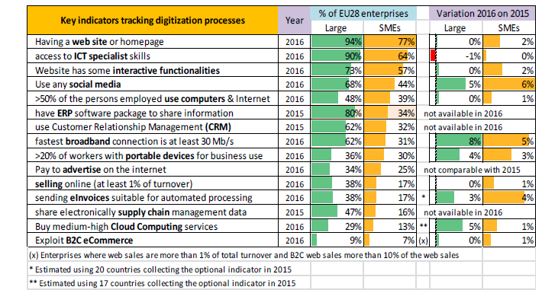

Slide 10
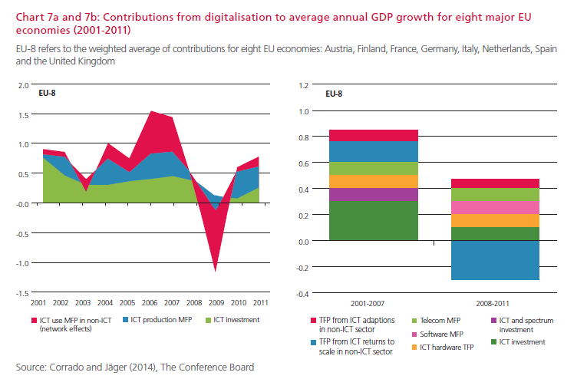

Slide 11
GDP Projections

Slide 12
Lost GPD

Slide 13
Lost revenues

Slide 14
Productivity Growth potential compared with EU Average = 529%

