Slide 1
Green Controlling and Eco-Engineering in UNESCO Protected Zones: Managing Hospitality Infrastructure at Lake Ohrid
Prof. Desa Kosarkoska Ph.D.,
University Professor of Accounting and Controlling
Faculty of Tourism and Hospitality Ohrid, UKLO Bitola
desa.kosarkoska@uklo.edu.mk

Slide 2
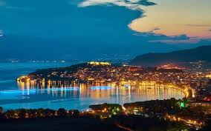
Good evening, ladies and gentlemen. My name is Desa Kosarkoska from the University of Bitola in North Macedonia. I am delighted to be here at the Alte Münze. Today, we are bridging two fields that are usually separated: STEM-based Environmental Engineering and Corporate Controlling

Slide 3
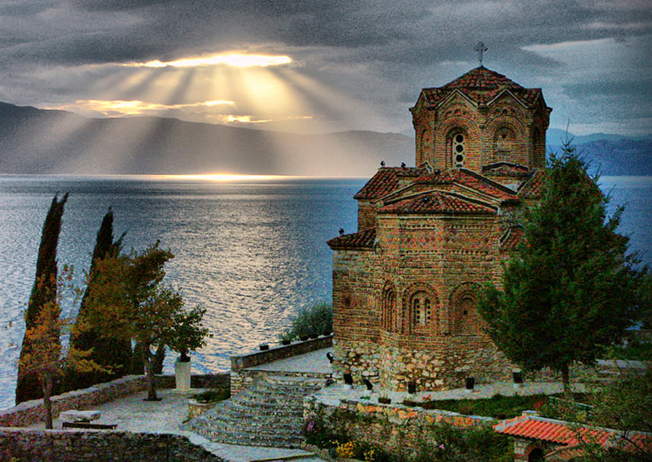
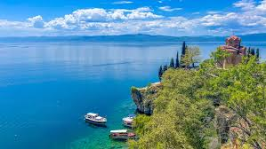
We face a global crisis. Tourism hubs are expanding, but they place a heavy ecological burden on fragile natural habitats. Our case study today is Lake Ohrid—a UNESCO World Heritage site. To save these ecosystems, we need advanced engineering. But to fund these technologies, we need Green Controlling. Controlling is the translator that turns engineering metrics into financial realities.

Slide 4
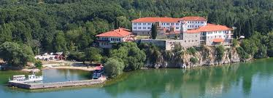
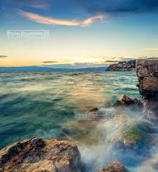
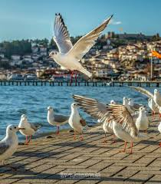
Managing a UNESCO protected zone requires precise data. At Lake Ohrid, seasonal tourism spikes place immense pressure on our waste management and water treatment systems. To prevent ecological degradation, municipal managers must track real-time eco-indicators. Green Controlling provides the specific financial tools required to fund, maintain, and scale these vital eco-engineering solutions.

Slide 5
The STEM Pillar (Eco-Technologies in Modern Hotels)
Let us look at the STEM side of modern hospitality infrastructure. Large hotels are no longer just service buildings. They are complex engineering networks. To comply with UNESCO standards, hotels must implement smart energy grids, automated HVAC heating and cooling systems, and advanced wastewater recycling plants.These systems generate massive amounts of raw data. They track kilowatts, water cubic meters, and carbon outputs. However, raw data alone cannot run a business. This brings us to the necessity of a managerial navigation system to make these engineering solutions sustainable in the long term.

Slide 6
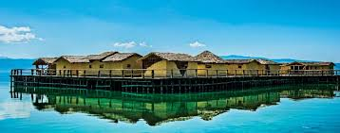
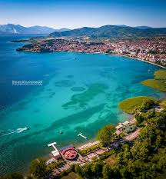
The Controlling Pillar (The Financial Bridge)
This is where Controlling comes in. As many of you know, Germany is the academic birthplace of modern Controlling. In this tradition, a controller is the "economic conscience" of an enterprise. Traditional controlling looks only at profit and immediate costs. But Green Controlling introduces a new metric: the Return on Environment.

Slide 7
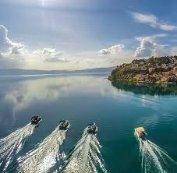
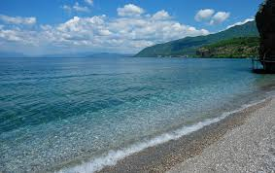
Green Controlling takes the raw data from environmental engineers and calculates long-term cost reductions. It shows management that investing in a high-cost wastewater system today prevents heavy state penalties and reduces resource consumption tomorrow. It bridges the gap between environmental science and corporate survival.

Slide 8
Case Study & Empirical Findings from Lake Ohrid
In my current research, I analyzed empirical data from hotel operators around the Macedonian side of Lake Ohrid. The data shows a clear trend.
Transitional economies face a high barrier due to the initial capital required for green engineering. Hotels using basic accounting view eco-technologies purely as an expensive burden. Conversely, hotels that implement structured international controlling frameworks—such as the Uniform System of Accounts for the Lodging Industry—successfully manage their seasonal volatility. They map out resource savings against peak summer demands and prove that green tech actively stabilizes their cash flow.

Slide 9
Conclusion & The Future of Interdisciplinary Research
In conclusion, the survival of our ecosystems relies on a strong partnership between STEM and Business. Engineers build the solutions, but controllers secure the funding and justify the strategy. By applying rigorous German-style controlling frameworks to fragile zones like Lake Ohrid, we ensure that sustainability is both ecological and financial.
Thank you very much for your time and your attention. I am now open to your questions.
desa.kosarkoska@uklo.edu.mk

Slide 10
As someone researching Controlling, coming to Germany is coming to the birthplace of modern managerial navigation. My goal for the Creative Bureaucracy Festival 2026 is to present a comparative perspective on how German Controlling methodologies are being adapted and implemented in Southeast European emerging markets such as North Macedonia, using my research at UKLO.
Prof. Desa

Slide 11
North Macedonia map
https://www.google.com/search?q=karta+makedonija&rlz=1C1GCEA_enMK1178MK1178&oq=karta+makedonija&gs_lcrp=EgZjaHJvbWUqCggAEAAY4wIYgAQyCggAEAAY4wIYgAQyBwgBEC4YgAQyCAgCEAAYFhgeMggIAxAAGBYYHjIICAQQABgWGB4yCggFEAAYChgWGB4yCAgGEAAYFhgeMggIBxAAGBYYHjIICAgQABgWGB4yCggJEAAYChgWGB7SAQg5OTgyajBqN6gCALACAA&sourceid=chrome&ie=UTF-8

