Slide 1
Gender (in)equality in rural Pelagonija – main socio-economic determinants

Slide 2
Content

Slide 3
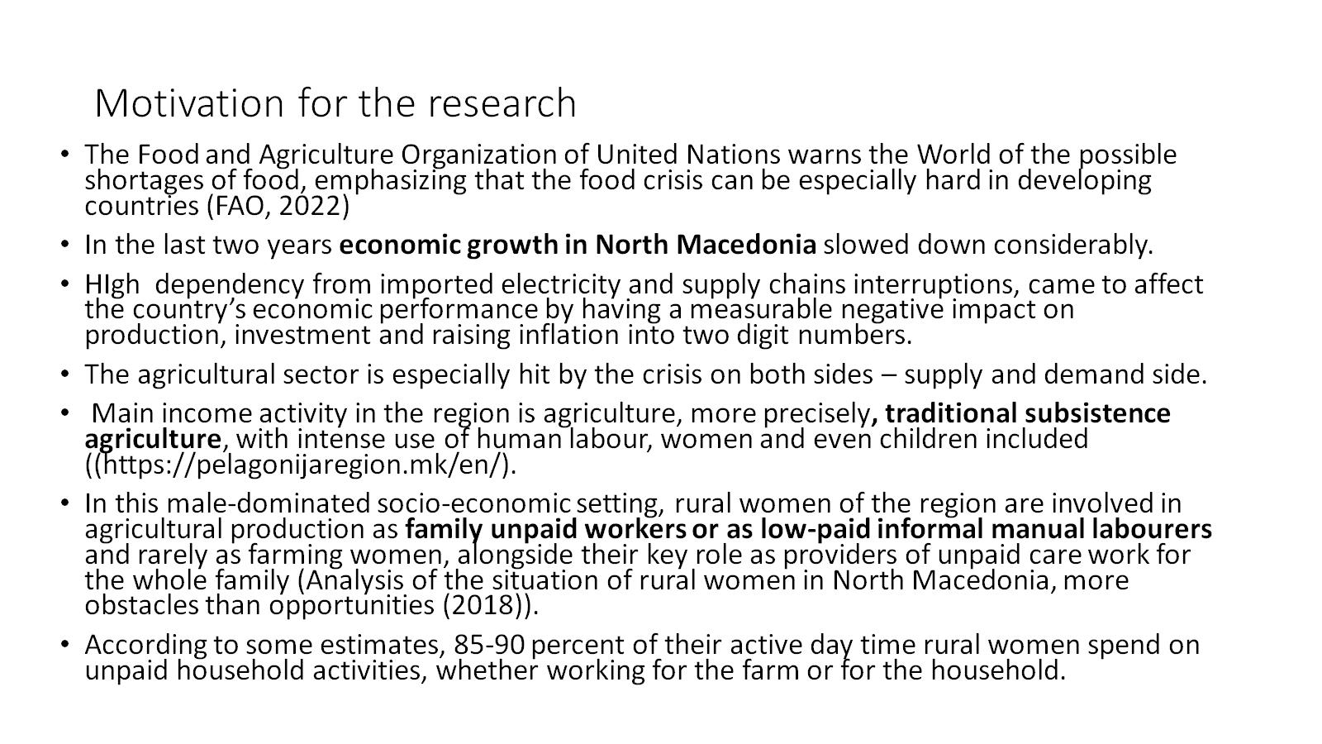
Motivation for the research

Slide 4
Legal background

Slide 5
Current economic situation

Slide 6
The research methodology

Slide 7
Some of the key findings

Slide 8
Key findings (2)

Slide 9
Key findings (3)

Slide 10
Key findings (3)

Slide 11
Policy recommendations

Slide 12
Conclusions

