Slide 1





LOCAL PERSPECTIVE: OHRID CULTURAL HERITAGE
www.colours-alliance.eu
COLOURS Summer School • Sustainable & Cultural Tourism • Ohrid • 7–13 Sep 2025

Slide 2


COLOURS Summer School • Sustainable & Cultural Tourism • Ohrid • 7–13 Sep 2025
LOCAL PERSPECTIVE: OHRID CULTURAL HERITAGE
www.colours-alliance.eu

Slide 3

TABLE
OF CONTENT
01. CULTURAL AND NATURAL HERITAGE OF OHRID
Introduction to Ohrid’s Cultural Heritage
Cultural Assets of Ohrid
Natural Assets of Ohrid
02. TOURISM AND SUSTAINABILITY
Sustainable tourism
        Reasons for sustainable tourism
3 pillars of sustainable tourism
Benefits of sustainable tourism
Statistical data on tourism in Ohrid
Some indicators for assessing the scale and impact of tourism on a destination
  Cultural tourism in Ohrid
03. SUSTAINABILITY CHALLENGES AND SOLUTIONS
Negative impacts of overtourism / excessive tourism
Recognized threats to Ohrid as a World Heritage Site
Impacts of overtourism on the cultural heritage of Ohrid
Recommendations for sustainable tourism practices in Ohrid
Revitalization of cultural heritage
COLOURS Summer School • Sustainable & Cultural Tourism • Ohrid • 7–13 Sep 2025

Slide 4

Cultural and Natural Heritage of Ohrid
01.
COLOURS Summer School • Sustainable & Cultural Tourism • Ohrid • 7–13 Sep 2025

Slide 5
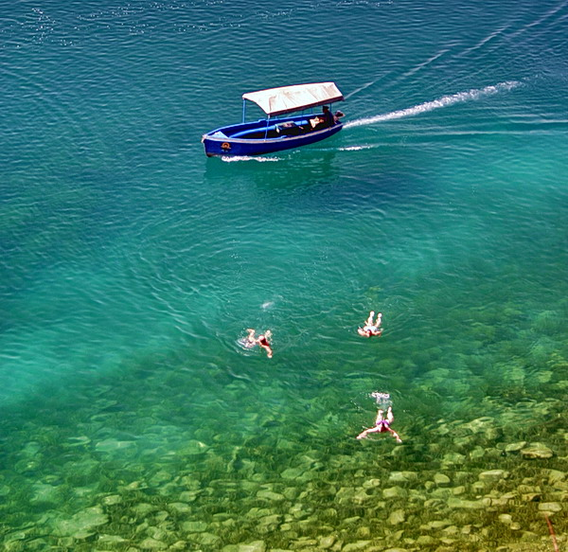
Introduction to Ohrid’s Cultural Heritage
OHRID - UNESCO World Heritage Site since 1979 (natural) and 1980 (cultural)
Called the “City of light” – ancient name Lychnidos, or ”Jerusalem of the Balkans”
Lake Ohrid - around 2 million years old. Highest percentage of endemism per unit area of any lake globally
The diversity of its cultural, material and spiritual heritage makes this region truly unique
The property encompasses all of the features that convey the property’s Outstanding Universal Value in relation to natural and cultural criteria.
Sources: UNESCO world heritage list - https://whc.unesco.org/en/list/99/ (2025), Wagner et al. (2021), Neubauer et al. (2015), Albrecht & Wilke (2008)
COLOURS Summer School • Sustainable & Cultural Tourism • Ohrid • 7–13 Sep 2025

Slide 6
Introduction to Ohrid’s Cultural Heritage
The property encompasses all of the features that convey the property’s Outstanding Universal Value in relation to natural and cultural criteria.
COLOURS Summer School • Sustainable & Cultural Tourism • Ohrid • 7–13 Sep 2025

Slide 7
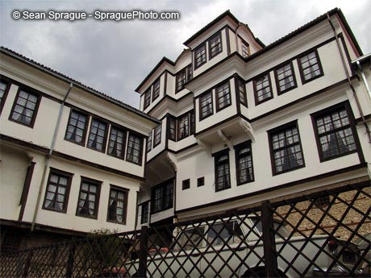
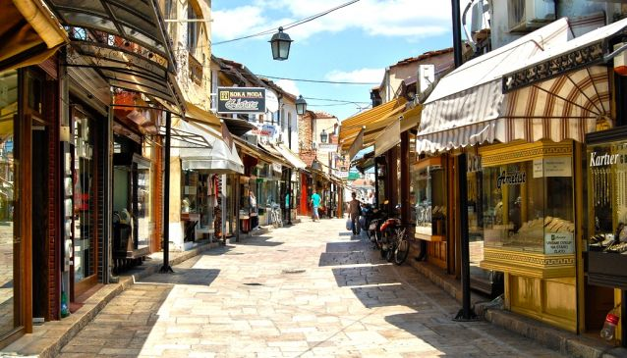
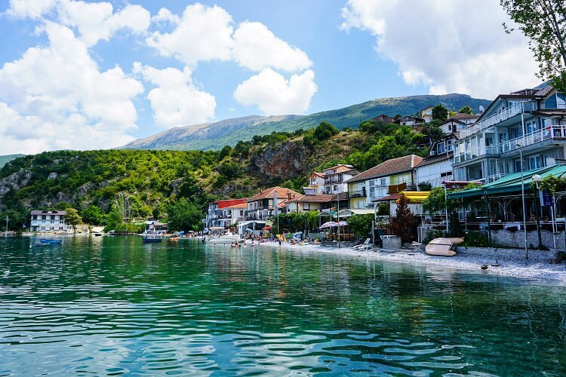
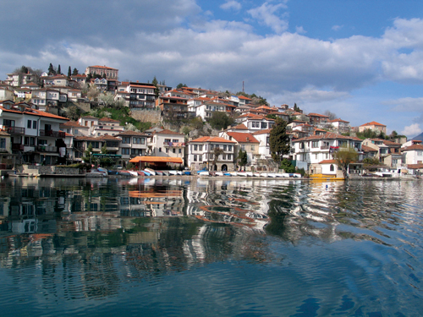
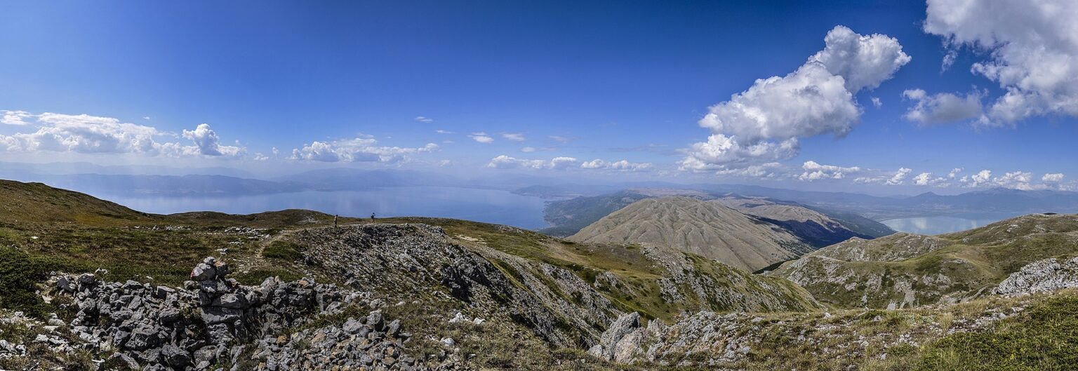
Cultural Assets of Ohrid
Cultural landscape of Ohrid, Old city core of Ohrid, Settlements on the lakeshore of Ohrid Lake and settlements located in rural areas
COLOURS Summer School • Sustainable & Cultural Tourism • Ohrid • 7–13 Sep 2025

Slide 8
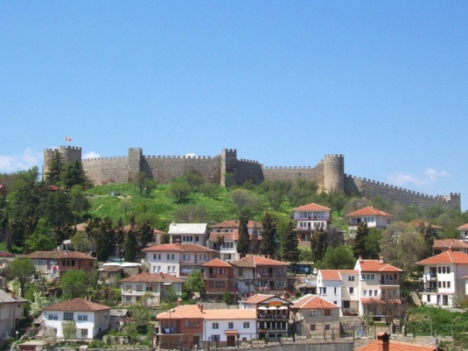
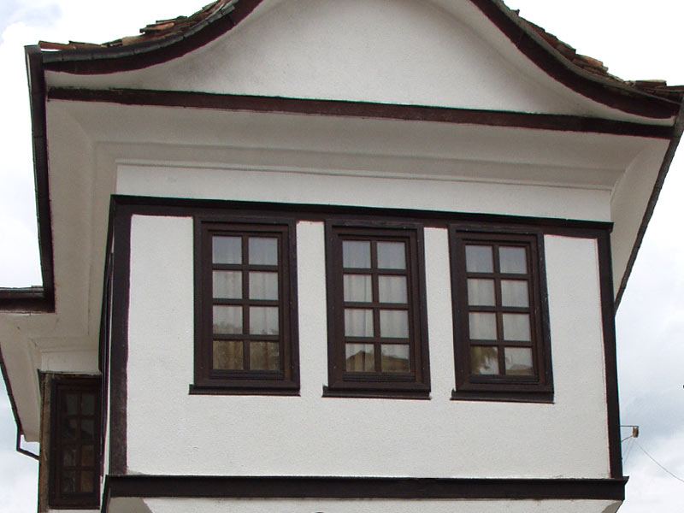
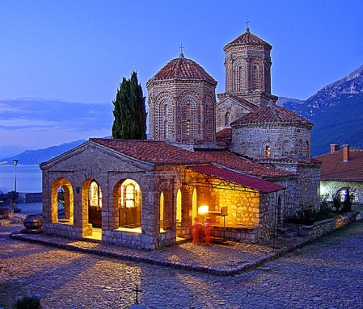
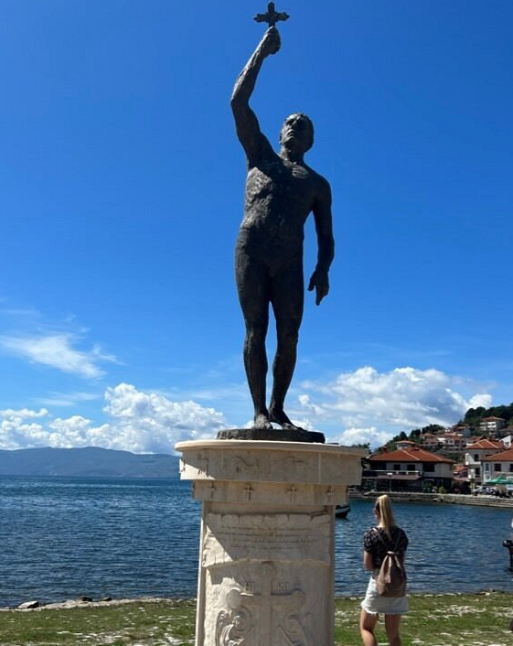
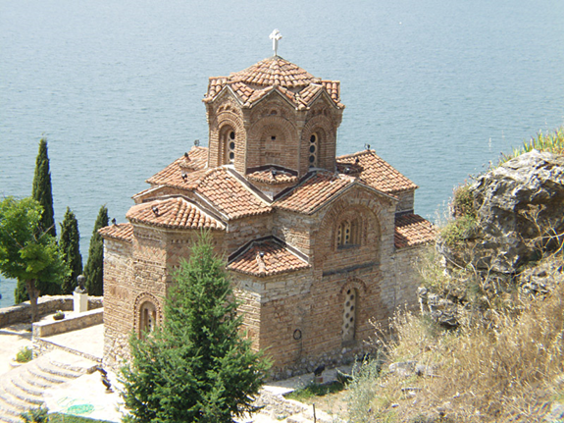
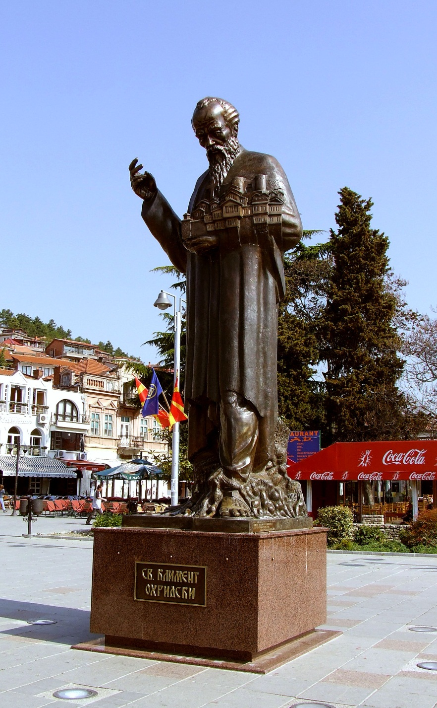
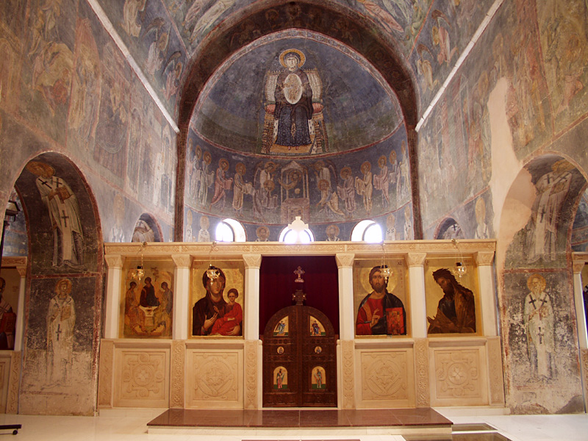
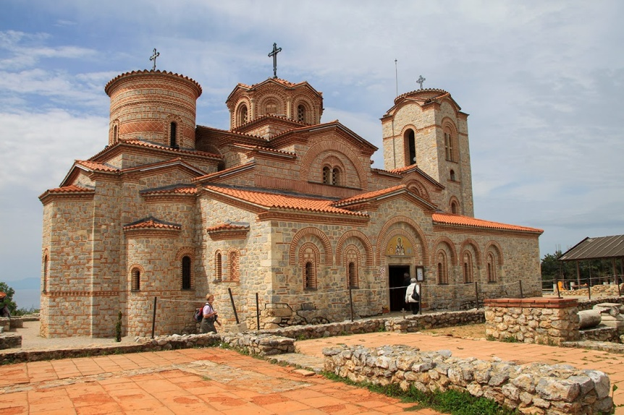
Cultural Assets of Ohrid
Sacral and profane architecture and buildings:
  St. Sophia church, Holy Mother of God Perivleptos church, St. John Theologian-Kaneo church, St. Naum church, St. Clement and Pantelejmon church, cave churches...
  Old city houses (Robevi, Uranija, Hristo Uzunov), monuments and memorials
COLOURS Summer School • Sustainable & Cultural Tourism • Ohrid • 7–13 Sep 2025

Slide 9
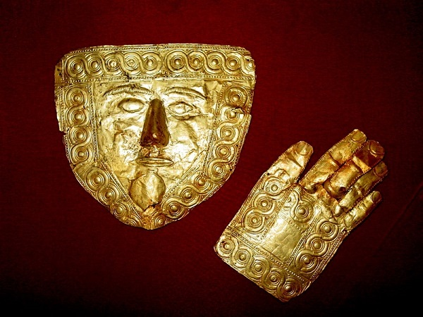
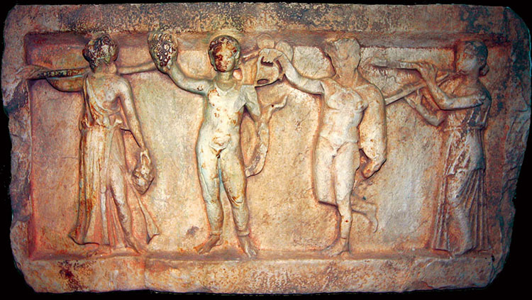
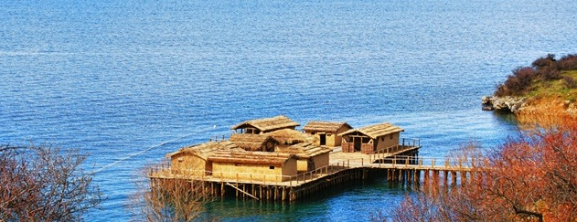
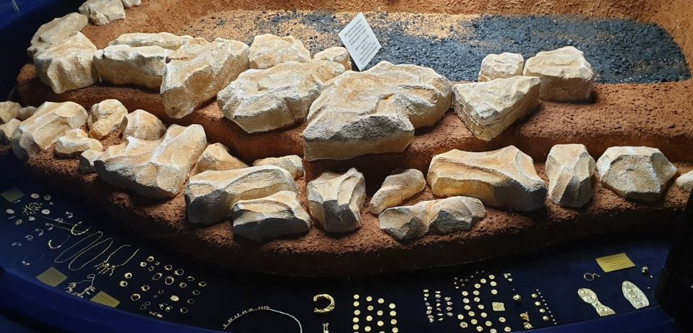
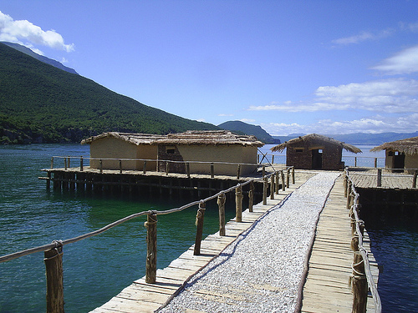
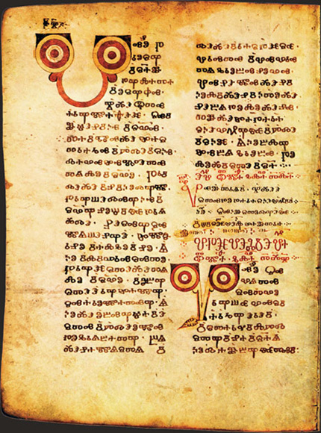
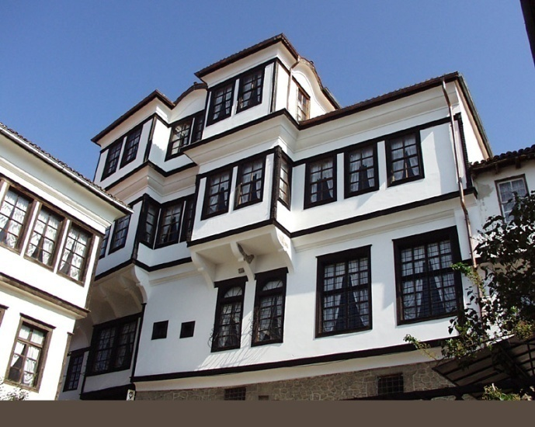
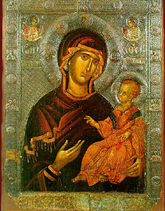
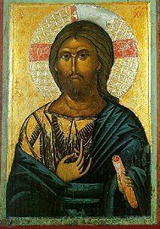
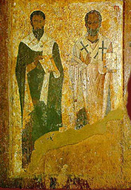
Cultural Assets of Ohrid
Museums: Icon Gallery, “Bay of bones – Michov Grad” – Pillar settlements, Museum of Slavic Literacy, archaeological museum – House of Robev family, Lapidarium…
COLOURS Summer School • Sustainable & Cultural Tourism • Ohrid • 7–13 Sep 2025

Slide 10
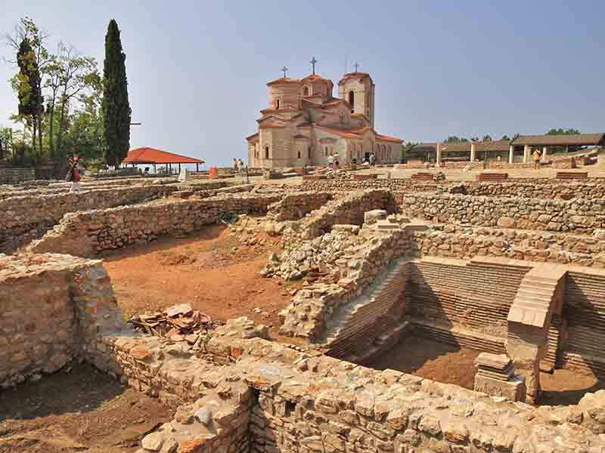
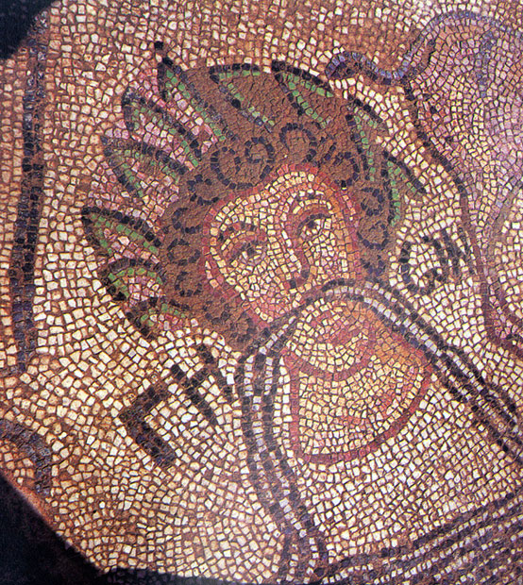
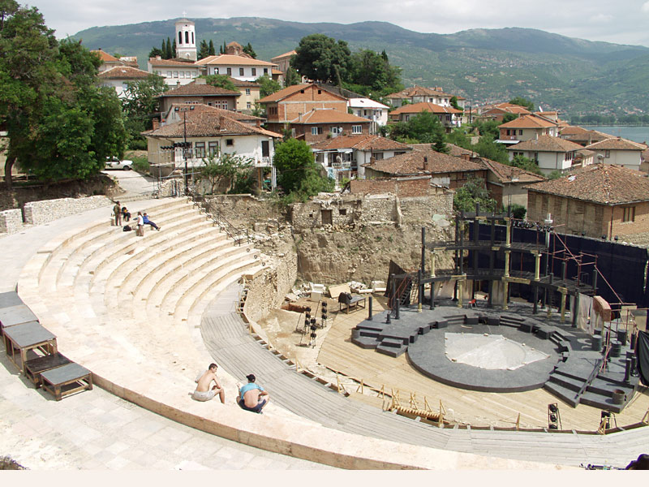
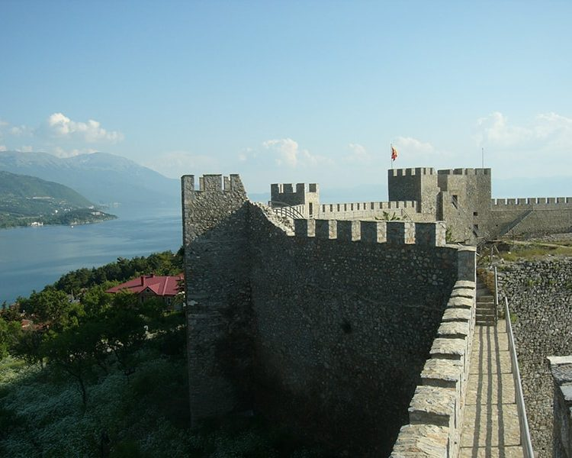
Cultural Assets of Ohrid
Archeological sites: Samuel’s Fortress, Plaoshnik, Ancient Theater, early christian basilicas…
COLOURS Summer School • Sustainable & Cultural Tourism • Ohrid • 7–13 Sep 2025

Slide 11
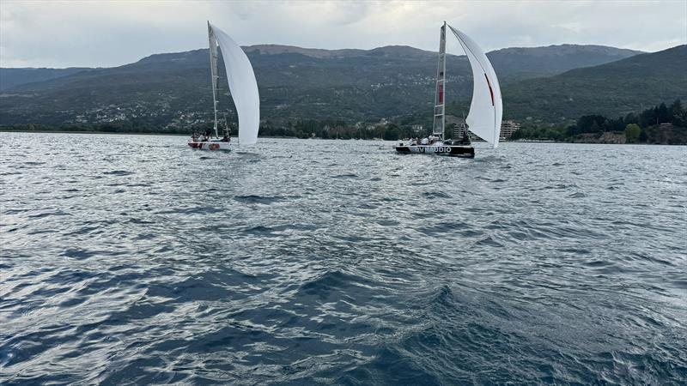
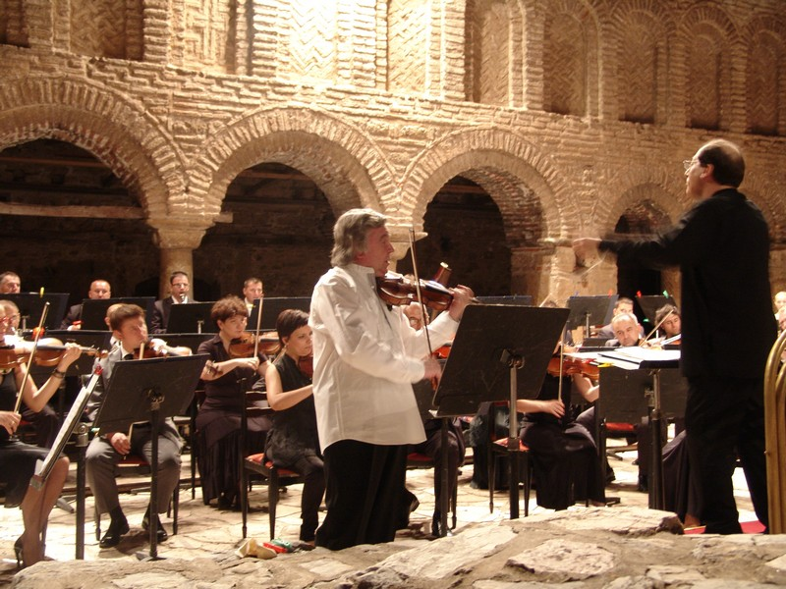
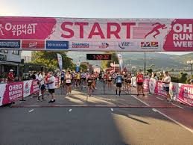
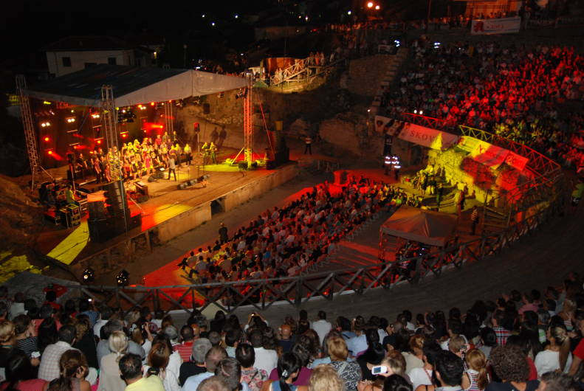
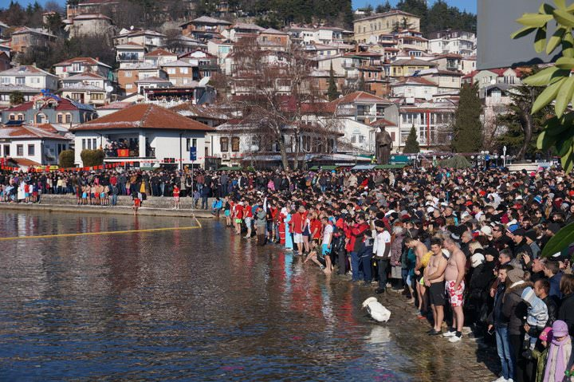
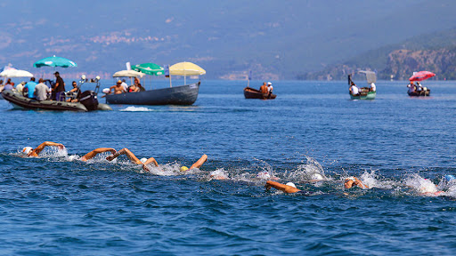
Cultural Assets of Ohrid
Events:
  Religious (Epiphany, Easter, celebration of St. Clement / St.Naum)
  Cultural (Ohrid Summer Festival)
  Sports events (Ohrid Swimming Marathon)
COLOURS Summer School • Sustainable & Cultural Tourism • Ohrid • 7–13 Sep 2025

Slide 12
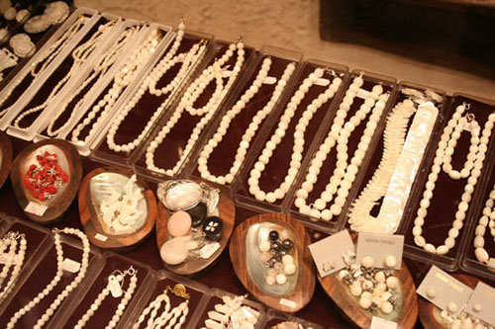
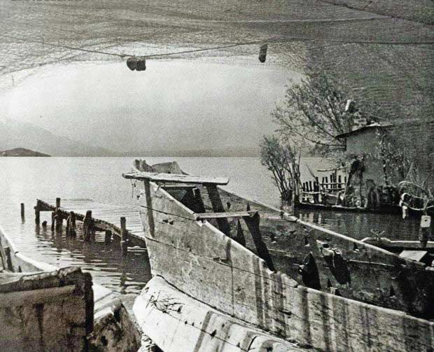
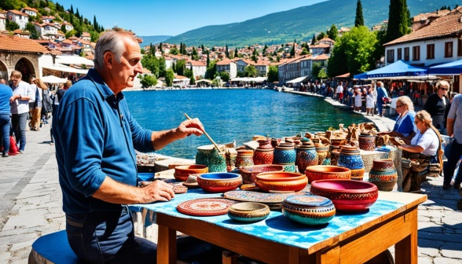
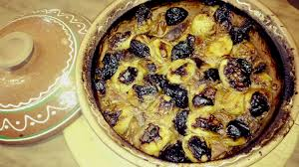
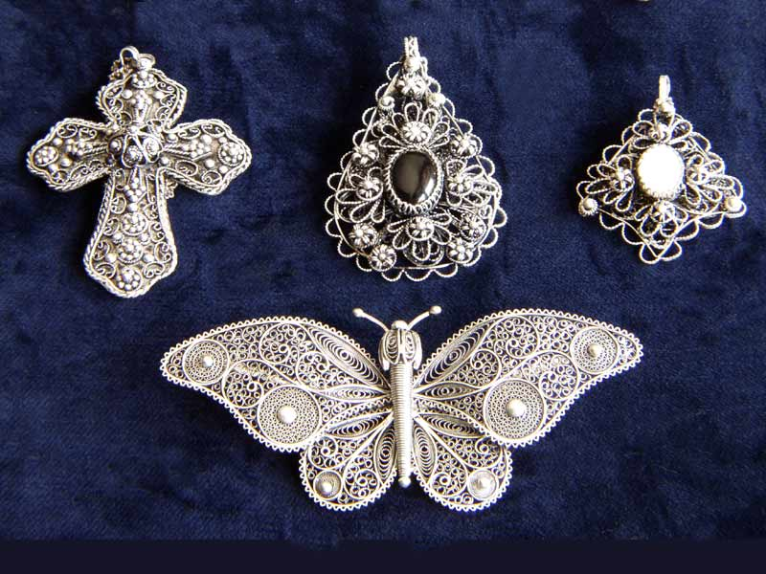
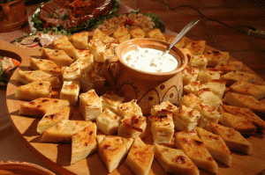
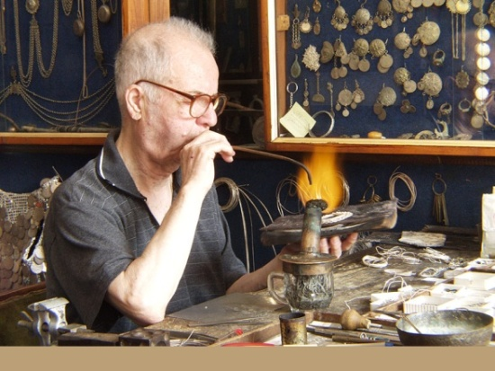
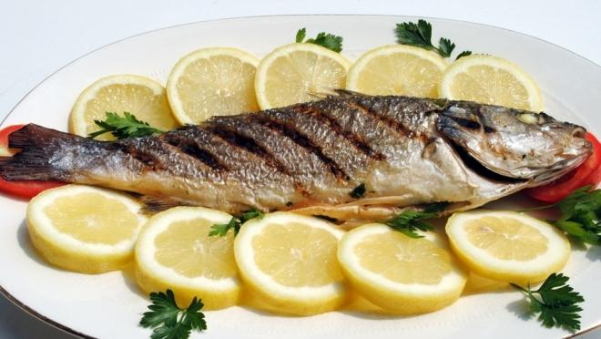
Cultural Assets of Ohrid
Ethnographic / folkloric heritage: traditional crafts (woodcarving, manufacturing handmade paper, Ohrid pearls, Filigree), traditional food
COLOURS Summer School • Sustainable & Cultural Tourism • Ohrid • 7–13 Sep 2025

Slide 13
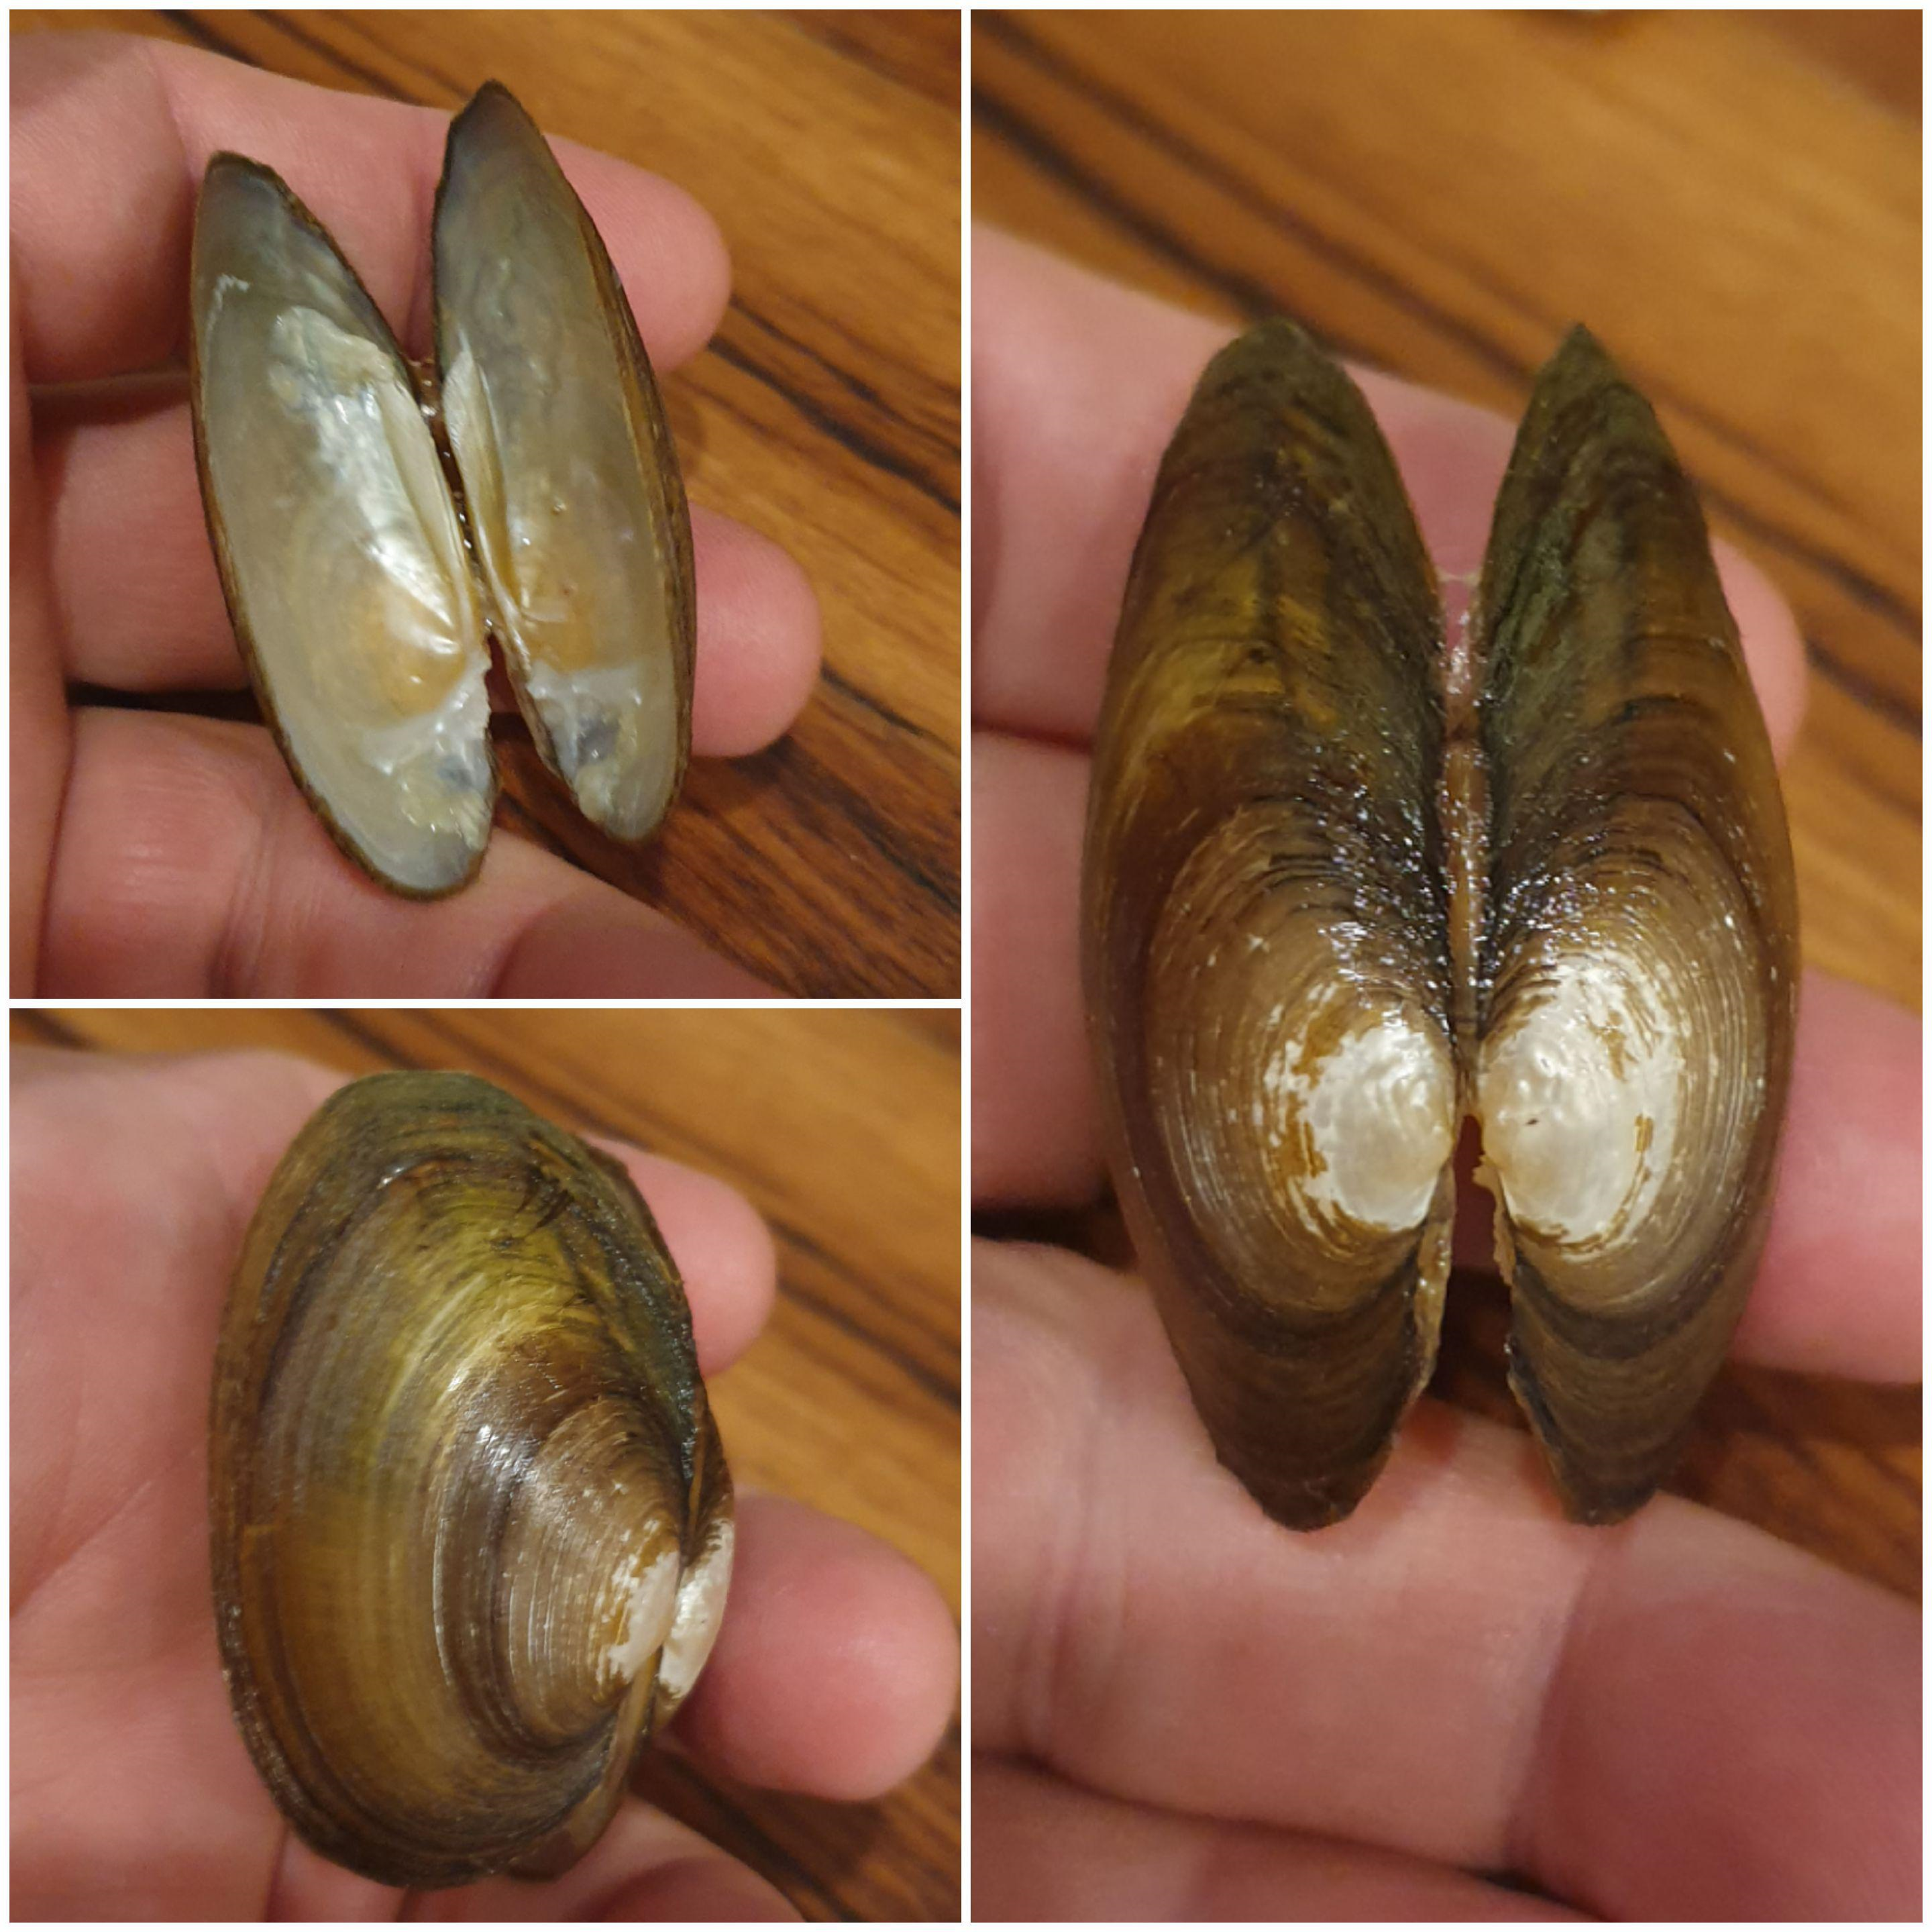
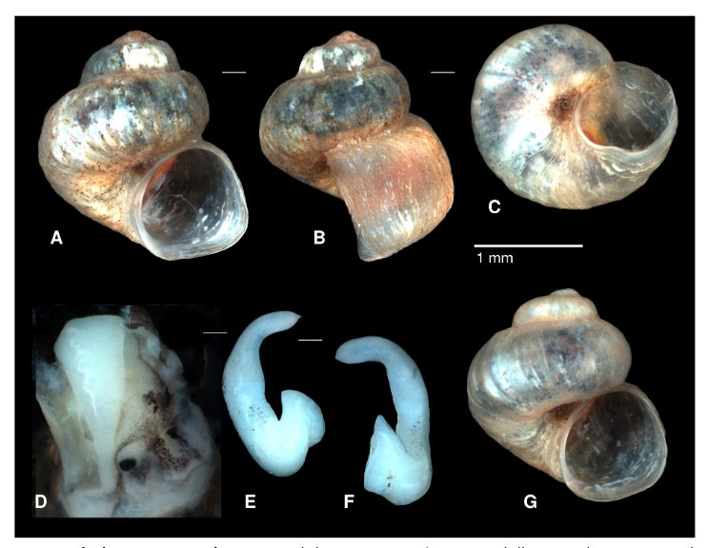
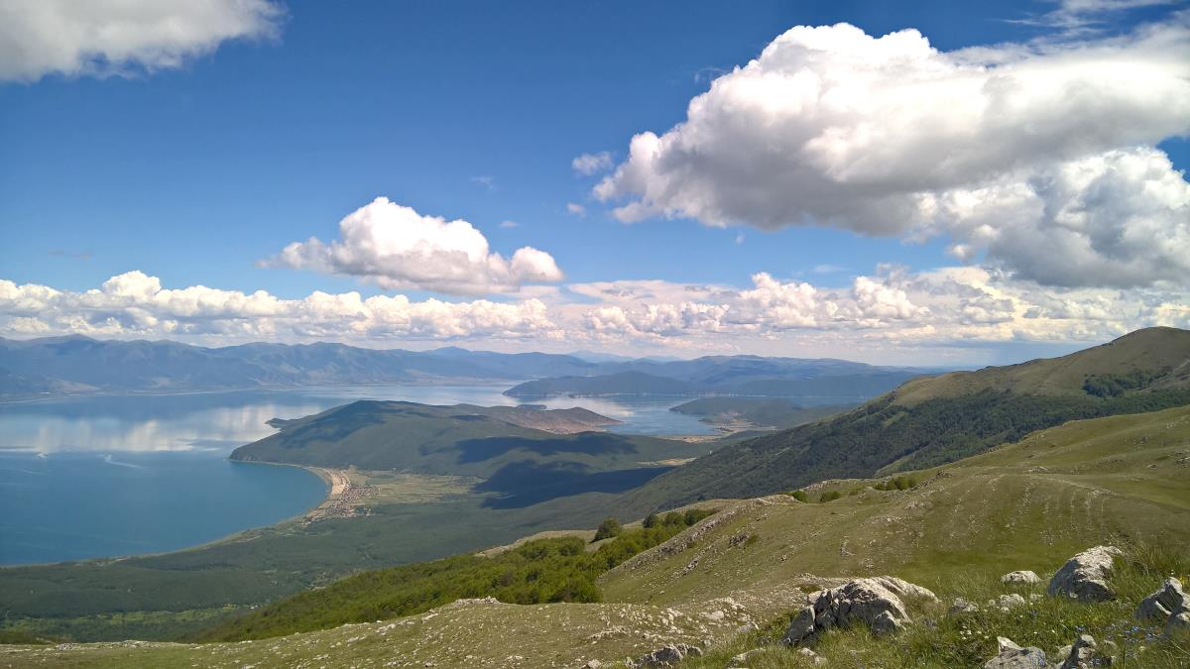
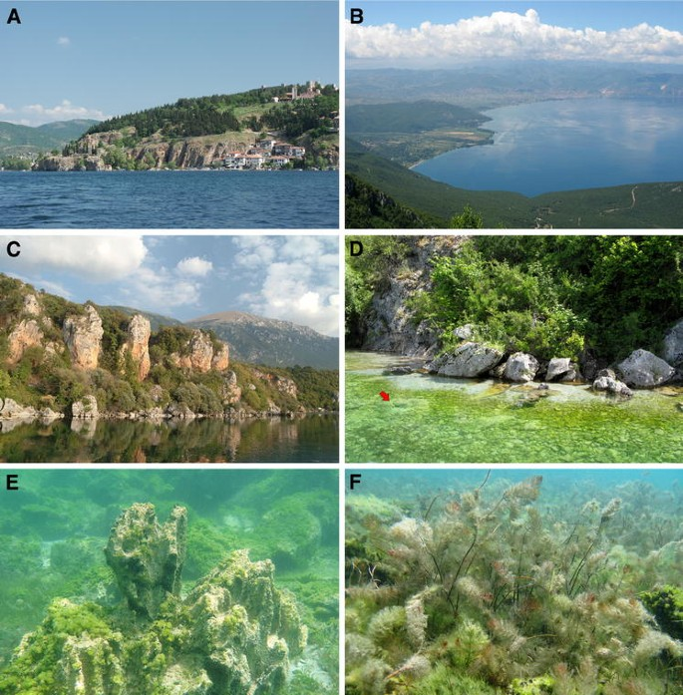
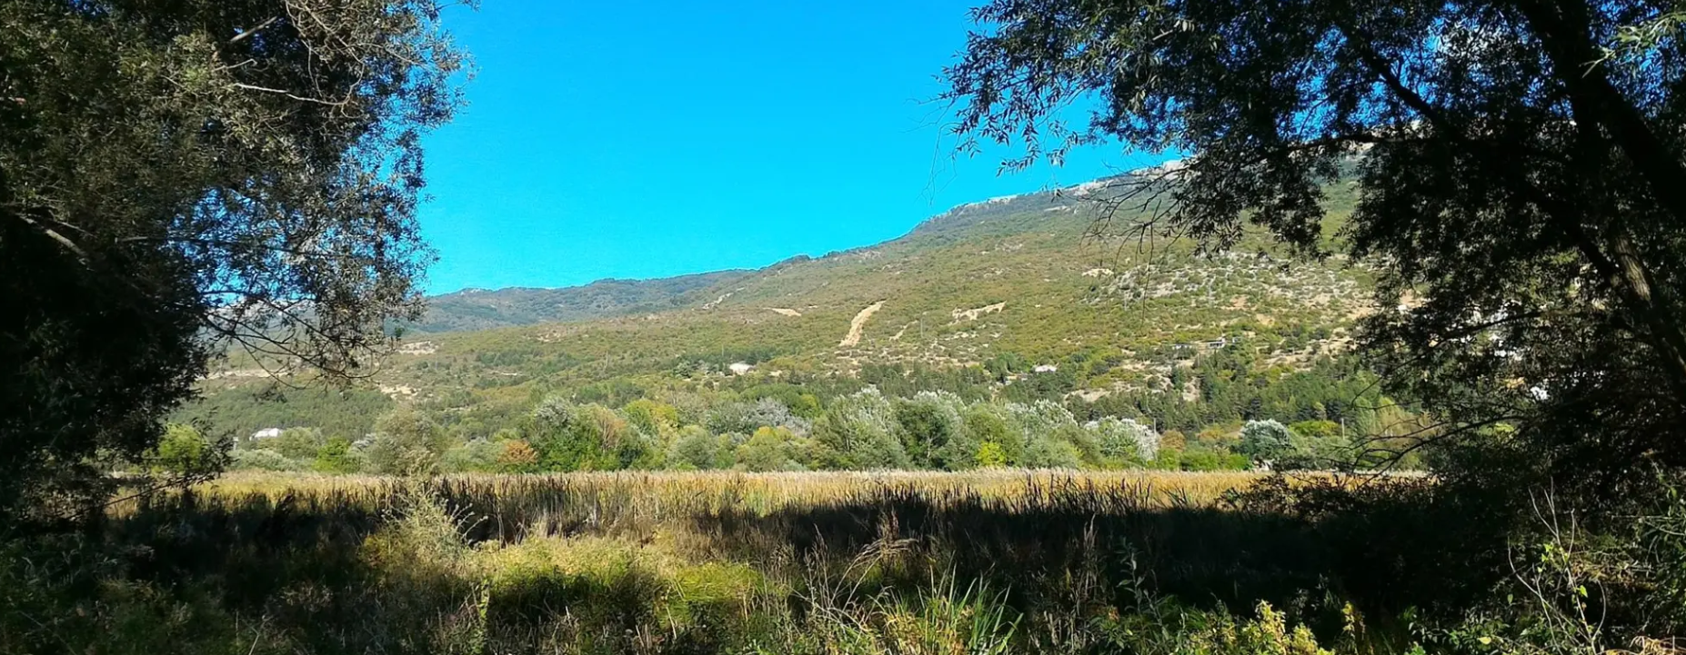
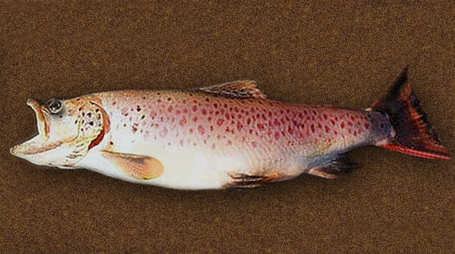
Natural Assets of Ohrid
Lake Ohrid and Galichica National Park – Biosphere Reserve “Ohrid-Prespa”.
Lake Ohrid’s biodiversity: of the 21 fish species, 8 are endemic to Lake Ohrid (“Museum of living fossils”).
Ohrid Lake and Studenchishte Marsh added to World Ramsar List in 2021
Sources: IUCN (2020), UNESCO (2025), Hales (2015).
COLOURS Summer School • Sustainable & Cultural Tourism • Ohrid • 7–13 Sep 2025

Slide 14
02.
Tourism and Sustainability
COLOURS Summer School • Sustainable & Cultural Tourism • Ohrid • 7–13 Sep 2025

Slide 15
Sustainable tourism
"Tourism that meets the needs of travelers while ensuring minimal negative impact on the environment, culture, and local communities. UNWTO (2023)“
Sustainable tourism includes all types of tourism and tourism products which actively contribute to:
- the conservation of an intact and diverse natural and cultural environment
- improving and maintaining the living standards of local people in the destinations
- encouraging and promoting an interest in learning, discovery and enjoyment
- long term economic success of tourism enterprises and destinations
COLOURS Summer School • Sustainable & Cultural Tourism • Ohrid • 7–13 Sep 2025

Slide 16
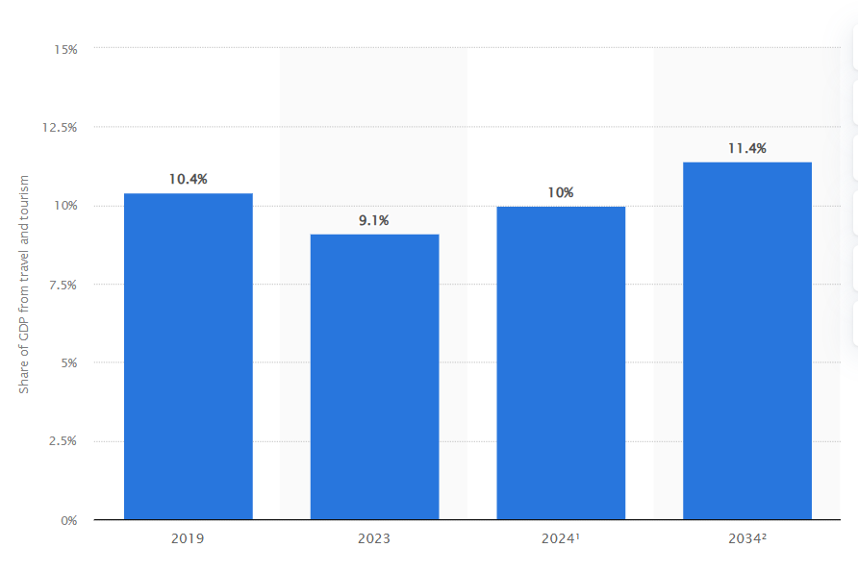
Reasons for sustainable tourism
Environmental Damage
Cultural Erosion
Economic decline of destinations
  Tourism accounts for 10% of global GDP
  In 2034, the tourism sector is expected to supercharge the global economy with a staggering $16TN, making up 11.4% of the entire economic landscape.
Sources: UNWTO (2024), WTTC (2025), Buckley (2021)
COLOURS Summer School • Sustainable & Cultural Tourism • Ohrid • 7–13 Sep 2025

Slide 17

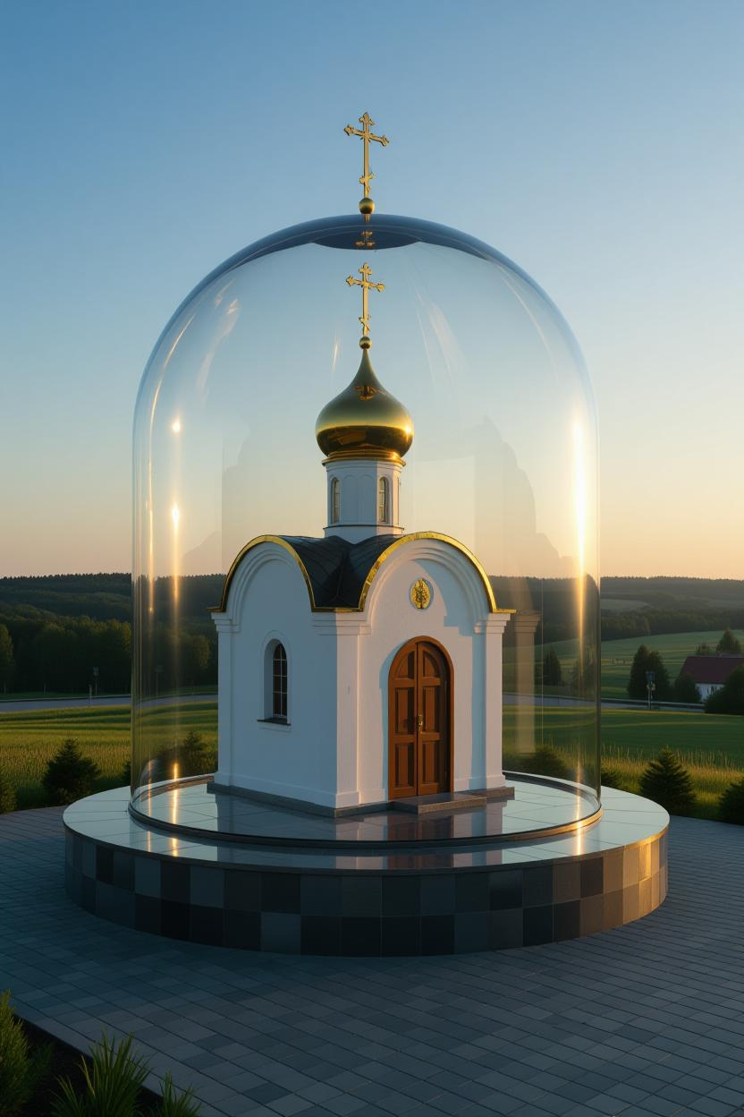
The 3 pillars of sustainable tourism
Environmental protection
Cultural preservation
Economic benefits (for locals)
COLOURS Summer School • Sustainable & Cultural Tourism • Ohrid • 7–13 Sep 2025

Slide 18



Benefits of sustainable tourism
For the Planet: Lower carbon footprint and habitat preservation
For Communities: Empowerment and improved quality of life
For Travelers: Authentic, meaningful experiences
Source: Weaver (2024)
COLOURS Summer School • Sustainable & Cultural Tourism • Ohrid • 7–13 Sep 2025

Slide 19
Tourism in Ohrid through some statistical data
In 2024 a total of 363.281 tourists visited Ohrid with a total of 1.194.516 nights spent. Foreign arrivals exceeded domestic arrivals by 1.46 times. While domestic overnights exceeded foreign by 1.7 times (fewer domestic tourists spent more nights in Ohrid than foreign tourists)
The number of tourist arrivals in Ohrid was 28.8 % of the country’s total, while nights spent in Ohrid represented 36.2 % of the total.
Sources: State Statistical Office (2025)
COLOURS Summer School • Sustainable & Cultural Tourism • Ohrid • 7–13 Sep 2025

Slide 20
Tourism in Ohrid through some statistical data
Peak season for domestic tourists in Ohrid is in July-August (80% of domestic overnights).
Percentage coverage of accommodation facilities
Sources: Andreeski et al.(2020), State Statistical Office (2025)
Jan | Feb | Mar | Apr | May | Jun | Jul | Aug | Sep | Oct | Nov | Dec
2% | 2% | 3% | 10% | 17% | 24% | 77% | 86% | 26% | 13% | 5% | 5%
COLOURS Summer School • Sustainable & Cultural Tourism • Ohrid • 7–13 Sep 2025

Slide 21

Some indicators for assessing the scale and impact of tourism on a destination
TD (Tourism Density)
TOURISM DENSITY = $\frac{\text{Number} \text{of} \text{Tourists}\text{ (}\text{or} \text{Visitor} \text{Arrivals}\text{)}}{\text{Area} \text{of} \text{Destination}\text{ (}\text{km}\text{²)}}$
TI (Tourism Intensity)
TOURISM INTENSITY = $\frac{\text{Number} \text{of} \text{Tourists}\text{ (}\text{or} \text{Visitor} \text{Arrivals}\text{)}}{\text{Local} \text{Population}}$
TP (Tourism Pressure) – The strain placed on infrastructure, resources, and ecosystems by tourism
COLOURS Summer School • Sustainable & Cultural Tourism • Ohrid • 7–13 Sep 2025

Slide 22
Tourism Density – Ohrid 2014-2024
Number of tourists per sq.km (Area: 390 km2)
Year month | 2014 | 2015 | 2016 | 2017 | 2018 | 2019 | 2020 | 2021 | 2022 | 2023 | 2024
Jan | 3,642 | 3,821 | 5,446 | 6,051 | 6,933 | 5,761 | 7,331 | 3,806 | 6,123 | 6,683 | 7,582
Feb | 2,281 | 2,395 | 3,524 | 3,265 | 3,608 | 3,236 | 5,239 | 4,279 | 4,607 | 5,787 | 6,293
Mar | 5,380 | 4,616 | 6,685 | 7,300 | 9,342 | 7,557 | 3,213 | 3,584 | 6,893 | 7,630 | 10,915
Apr | 10,215 | 12,447 | 14,175 | 18,485 | 21,390 | 23,753 | 258 | 3,927 | 12,029 | 18,722 | 22,929
May | 24,225 | 27,269 | 28,070 | 32,047 | 30,587 | 32,260 | 131 | 9,090 | 22,589 | 33,860 | 32,797
Jun | 19,492 | 21,772 | 21,650 | 25,247 | 30,366 | 35,659 | 610 | 13,589 | 25,398 | 35,861 | 37357
Jul | 40,487 | 43,089 | 47,300 | 54,622 | 57,683 | 60,531 | 35,812 | 50,320 | 59,289 | 65,818 | 70773
Aug | 44,402 | 50,996 | 47,719 | 57,670 | 62,890 | 65,685 | 57,463 | 63,716 | 62,933 | 72,259 | 79613
TD Aug | 113.9 | 130.8 | 122.4 | 147.9 | 161.3 | 168.4 | 147.3 | 163.4 | 161.4 | 185.3 | 204.1
Sep | 20,519 | 23,529 | 25,637 | 31,664 | 32,876 | 38,333 | 15,003 | 25,397 | 35,903 | 40,726 | 40988
Oct | 16,027 | 15,037 | 20,088 | 21,607 | 22,056 | 27,511 | 6,464 | 12,159 | 25,960 | 26,128 | 29699
Nov | 5,792 | 6,931 | 7,647 | 8,390 | 8,791 | 11,683 | 4,129 | 7,245 | 11,858 | 13,340 | 13415
Dec | 4,734 | 8,042 | 8,420 | 9,265 | 9,524 | 10,604 | 7,173 | 7,828 | 9,688 | 10,324 | 10920
Low s. total | 48,071 | 53,289 | 65,985 | 74,363 | 81,644 | 90,105 | 33,807 | 42,828 | 77,158 | 88,614 | 101753
TD low s. /monthly | 18 | 20 | 24 | 27 | 30 | 33 | 12 | 16 | 28 | 32 | 37
High s. total | 149,125 | 166,655 | 170,376 | 201,250 | 214,402 | 232,468 | 109,019 | 162,112 | 206,112 | 248,524 | 261528
TD high s./monthly | 76 | 85 | 87 | 103 | 110 | 119 | 56 | 83 | 106 | 127 | 134
Ann. Total | 197,196 | 219,944 | 236,361 | 275,613 | 296,046 | 322,573 | 142,826 | 204,940 | 283,270 | 337,138 | 363,281
TD Annually | 505.6 | 564.0 | 606.1 | 706.7 | 759.1 | 827.1 | 366.2 | 525.5 | 726.3 | 864.5 | 931.5
COLOURS Summer School • Sustainable & Cultural Tourism • Ohrid • 7–13 Sep 2025

Slide 23
Tourism Intensity – Ohrid 2014-2024
Number of tourists’ overnights per 100 residents (No. of inhabitants in the Municipality of Ohrid: 51.428)
Year month | 2014 | 2015 | 2016 | 2017 | 2018 | 2019 | 2020 | 2021 | 2022 | 2023 | 2024
Jan | 5,906 | 6,238 | 9,936 | 11,815 | 13,175 | 9,952 | 13,103 | 8,193 | 11,736 | 12,432 | 13,251
Feb | 4,917 | 5,625 | 8,676 | 7,047 | 8,238 | 7,201 | 10,488 | 7,850 | 9,749 | 10,957 | 11,913
Mar | 8,559 | 7,776 | 11,578 | 12,693 | 17,168 | 12,955 | 6,229 | 6,883 | 14,252 | 12,615 | 20,509
Apr | 18,349 | 20,521 | 24,251 | 32,637 | 36,482 | 39,712 | 1,576 | 6,568 | 22,020 | 33,726 | 37,401
May | 53,177 | 56,020 | 55,056 | 63,864 | 59,987 | 68,060 | 797 | 17,506 | 46,759 | 72,171 | 59,990
Jun | 56,363 | 62,040 | 59,509 | 69,126 | 89,635 | 93,437 | 1,397 | 35,589 | 64,673 | 82,379 | 84795
Jul | 241,668 | 254,026 | 255,262 | 968,903 | 298,130 | 314,554 | 23,439 | 287,429 | 320,233 | 335,996 | 357324
Aug | 264,581 | 289,338 | 266,732 | 306,007 | 335,425 | 355,011 | 334,037 | 366,606 | 366,595 | 398,444 | 426138
TI Aug | 514 | 563 | 519 | 595 | 652 | 690 | 650 | 713 | 713 | 775 | 829
Sep | 51,139 | 60,047 | 67,244 | 87,522 | 951,171 | 104,559 | 44,283 | 62,691 | 78,357 | 94,031 | 88504
Oct | 31,065 | 27,447 | 42,216 | 41,839 | 44,456 | 54,503 | 13,809 | 22,847 | 54,635 | 50,432 | 52204
Nov | 8,948 | 13,343 | 15,279 | 17,205 | 16,789 | 21,012 | 8,214 | 14,873 | 20,106 | 21,581 | 22307
Dec | 8,376 | 15,754 | 14,594 | 18,383 | 20,202 | 20,607 | 13,902 | 13,715 | 17,302 | 19,236 | 20180
Low s. total | 86,120 | 96,704 | 126,530 | 141,619 | 156,510 | 165,942 | 67,321 | 80,929 | 149,800 | 160,979 | 177765
TI low s. /monthly | 24 | 27 | 35 | 39 | 43 | 46 | 19 | 22 | 42 | 45 | 49
High s. total | 666,928 | 721,471 | 703,803 | 1,495,422 | 1,734,348 | 935,621 | 403,953 | 769,821 | 876,617 | 983,021 | 1016751
TI high s. /monthly | 259 | 281 | 274 | 582 | 674 | 364 | 157 | 299 | 341 | 382 | 395
Ann.Total | 753,048 | 818,175 | 830,333 | 1,637,041 | 1,890,858 | 1,101,563 | 471,274 | 850,750 | 1,026,417 | 1,144,000 | 1372281
TI annually | 1,464 | 1,591 | 1,615 | 3,183 | 3,677 | 2,142 | 916 | 1,654 | 1,996 | 2,224 | 2,668
COLOURS Summer School • Sustainable & Cultural Tourism • Ohrid • 7–13 Sep 2025

Slide 24
Tourism Density (TD) and Tourism Pressure (TP) - measured for RN Macedonia and the Municipality of Ohrid (2019)
2019 | Beds | Number of tourists | Number of tourists’ overnights | TD₁ | TP (overnights per bed) | TD₂
 |  |  |  | (number of tourists per sq. km) |  | (overnights per sq. km)
RN Macedonia | 76942 (100%) | 1184963 (100%) | 3262398 (100%) | 46 | 42 | 127
Municipality of Ohrid | 13241 (17%) | 322,573 (27%) | 1,101,563 (34%) | 827 | 83 | 2,825
Tourism revenues in Ohrid contribute to 1.5% of the total GDP of RN Macedonia.
The income of employees in the Accommodation and Food Services Sector in Ohrid amounts to 6.24% of the total incomes in the municipality
Sources: State Statistical Office (2025), Trajkov et al. (2019)
COLOURS Summer School • Sustainable & Cultural Tourism • Ohrid • 7–13 Sep 2025

Slide 25

Cultural tourism in Ohrid
Huge portion of tourists visit Ohrid because of the cultural heritage (mainly foreign tourists)
Cultural tourism can be considered as being a growing type of tourism which accounts for approximately 40% of the total number of tourist trips worldwide
Important priorities and policies for developing cultural tourism:
  understanding tourist behavior
  understanding cultural identity and diversity
  diversifying tourist activities
  balancing protection and promotion
The stakeholders in a destination are diverse and often have contradictory interests and agendas
Source: UNWTO (2018)
COLOURS Summer School • Sustainable & Cultural Tourism • Ohrid • 7–13 Sep 2025

Slide 26

Cultural tourism in Ohrid
Tourism generates a large portion of the revenue in the municipality of Ohrid – 33.8 % of the total tourism revenue nationally
One study shows:
  78.4% of the locals regard tourism to play an important role in widening the possibilities for shopping, eating in restaurants and amusement,
  85.6% think that they have some benefits from tourism development, while 46.6% answered that tourism has improved the quality of public services
The need for innovative tourism products / package tours
Source: Andreeski et al.(2020)
COLOURS Summer School • Sustainable & Cultural Tourism • Ohrid • 7–13 Sep 2025

Slide 27
Sustainability Challenges and Solutions
03.
COLOURS Summer School • Sustainable & Cultural Tourism • Ohrid • 7–13 Sep 2025

Slide 28
Negative impacts of overtourism / excessive tourism
Environmental impacts
  Straining local ecosystems
  Pollution (solid waste and wastewater)
  Depletion of natural resources
Socio-cultural impacts
  Eroding local traditions and authenticity
  Commercialization / Commodification
  Disturbances of public order
  Resentment towards visitors
  Crowding and traffic congestions
Economic impacts
  Exploitation of the local workforce
  Seasonal workforce
  Diverting investments to infrastructure development instead conservation / preservation
  Source: Hall et al. (2021)
COLOURS Summer School • Sustainable & Cultural Tourism • Ohrid • 7–13 Sep 2025

Slide 29
Recognized threats to Ohrid as a World Heritage Site
The OUV (Outstanding Universal Value) of the Ohrid Region is threatened
A Reactive Monitoring Mission by UNESCO was conducted in 2017 in order to evaluate the state of protection. Some of the recognized pressures/threads are the following:
  The construction of Corridor VIII (Pan-European transport corridor designed to connect the Adriatic Sea with the Black Sea, road and railway) and A2 highway
  Construction of A3 road (within Galichica National Park)
  The planned Ski-center within Galichica National Park
  Transformation of the shoreline of Lake Ohrid
  To implement a Strategy for development of Tourism that will take into account the OUV of the destination
  Detailed inventory on all illegal buildings and conduct Environmental Impact Assessment and Heritage Impact Assessment / demolition of all illegal buildings
  Determining the contact zones of the National Park
  Improving cooperation with Albania
  Connecting all settlements around Lake Ohrid to the System of Wastewater Treatment
  Regulating traffic, especially within the Old City Core
  Protection of archeological sites and historical buildings, taking into account authenticity and integrity
Sources Management Plan of the World Natural and Cultural Heritage of the Ohrid Region 2020-2029
COLOURS Summer School • Sustainable & Cultural Tourism • Ohrid • 7–13 Sep 2025

Slide 30

Impacts of overtourism on the cultural heritage of Ohrid
Tourism (if poorly managed) can cause negative impacts on culture and cultural heritage and possibly threaten the long term sustainability of both sectors: tourism and culture
  Lack of visitor management, monitoring visitor flows, Carrying capacity assessments, Cooperation between stakeholders…
The increase in tourism visits shows the most negative impacts on the cultural and natural environment:
  changed physiognomy of the Old city core with inadequate billboards, installation of solar panels and satellite dishes; renovation of old houses with inappropriate materials; inappropriate conversion of old buildings for commercial use;
  crowded cultural sites – physical damage (wear and tear)
  increased pollution
  traffic increases air pollution and vibrations may cause damage to cultural sites and monuments
  illegal construction
  overfishing and illegal fishing due to a higher demand for fish specialties;
  overflowing of wastewater from the wastewater collection system around the Ohrid Lake due to the system’s insufficient capacity
Sources: Andreeski et al.(2020), UNWTO (2018)
COLOURS Summer School • Sustainable & Cultural Tourism • Ohrid • 7–13 Sep 2025

Slide 31
Impacts of overtourism on the local population in Ohrid
Economic impacts
  Higher costs for maintenance of tourism infrastructure
  Higher living costs
  Insufficient available workforce
Environmental impacts
  Losing traditional values - commodification (changing of local architecture, cheap souvenirs instead of local traditional products)
  Inadequate construction of buildings
  Increased pollution and degradation of the environment
  Depletion of resources (water and energy outages)
Socio-cultural impacts
  Wear and tear of cultural sites – especially churches
  Limited access to the own cultural sites due to overcrowding
  UNESCO status means stricter regulations to which locals must follow (traditional houses)
COLOURS Summer School • Sustainable & Cultural Tourism • Ohrid • 7–13 Sep 2025

Slide 32
Impacts of overtourism on the local population in Ohrid
From a study conducted on the local population about their perception of tourism development and its influence on sustainability of the heritage site: locals do not perceive the environmental dimension of sustainability to be of very high priority.
Furthermore, locals perceive intensively the negative effects of destructive human activities. Inadequate buildings (in the old city-center and along the lakeshore, illegal building construction, etc.) destroy the traditional architecture in Ohrid.
Environmental effects are much less perceived (less important)
Source: Petrevska & Mihalic, (2020)
COLOURS Summer School • Sustainable & Cultural Tourism • Ohrid • 7–13 Sep 2025

Slide 33




Recommendations for sustainable tourism practices in Ohrid
Developing sustainable tourism products, new tourism zoning is needed, shifting the focus on rural areas around Ohrid and providing eco-tourism activities and experiences
A global trend is the increase of community-led tourism / authentic experiences.
Adopting “green” transport (biking, public transport, walking, electrical vehicles, etc.)
Reusable supplies and minimal packaging
Minimizing/re-using waste (e.g. gastronomy)
Promoting lesser known natural and cultural sites in order to minimize overcrowding in the main tourism spots of Ohrid. Thematic routes “1.100 years of St. Clement”
Using digital tools like VR tours to reduce site impact
COLOURS Summer School • Sustainable & Cultural Tourism • Ohrid • 7–13 Sep 2025

Slide 34
Revitalization of cultural heritage
Revitalization is a more complex category than conservation.
Revitalization of cultural heritage through inclusion in tourism offer with active involvement of the local population (engaged as educators, tour guides, experts, etc.).
Visitors transform into active participants (not just passive onlookers).
Different cultural events should be organized. Not only to promote cultural practices and traditions, but also the generated incomes can be directed towards further protection activities of cultural heritage
Through revitalization the tourists’ stay is being enriched – it impacts the prolonging the tourism season
COLOURS Summer School • Sustainable & Cultural Tourism • Ohrid • 7–13 Sep 2025

Slide 35
Revitalization of cultural heritage in Ohrid – some recommendations
Cultural landscape – Promotion activities
Old city complexes (old city core and Bazaar) - “living heritage”
Specific settlements (villages on the lakeshore, rural areas) – accommodation and food in traditional environments with breathtaking viewpoints
Sacral architecture (churches, monasteries) – fusion of traditional and modern elements (some events are being held within). Monasteries provide the possibility to accommodate tourists
Profane architecture (old city houses, Hammam, clock, tower) – some could be used for tourism purposes as accommodation facilities
Archeological sites - diversification of cultural tourism products
Museums – possibility for innovative presentation / characteristics of visitor centers
Events - tourists can sometimes actively participate providing unique experience of the local traditions and customs (religious), some have promotional value (cultural)
Ethnographic heritage (Ohrid trout, Ohrid pearls, woodcarving, paper manufacturing, filigree) - tourists can buy authentic products from the visited place, some of them are recognizable brands
Source: Korunovski & Risteski (2023)
COLOURS Summer School • Sustainable & Cultural Tourism • Ohrid • 7–13 Sep 2025

Slide 36
References
Albrecht and Wilke, (2008) Ancient Lake Ohrid: biodiversity and evolution, Hydrobiologia, vol. 615, no. 1, pp. 103-140,
Andreeski, C., Marinoski, N., Korunovski, S. & Risteski, M. (2020). Strategy for Tourism Development in the Municipality of Ohrid 2020-2025. Ohrid: Faculty of Tourism and Hospitality – Ohrid and Municipality of Ohrid
Hales, J. (2015) Southeast Adriatic Drainages, Freshwater Ecoregions of the World
Hall, C. M., Lundmark, L., & Zhang, J. J. (2021). Conclusions – degrowing tourism : Can tourism move beyond BAU (Brundtland-as-Usual)? In Degrowth and tourism (pp. 239–248).
IUCN (2020). World Heritage Outlook: Natural and Cultural Heritage of the Ohrid Region. https://worldheritageoutlook.iucn.org
Korunovski S. and Risteski M. (2023) The City of Ohrid as a UNESCO World Cultural Heritage Site: Challenges and Solutions for Cultural Tourism Development, Cities' Vocabularies and the Sustainable Development of the Silkroads - Advances in Science Technology & Innovation, vol. 1, pp. 347-361, 2023
Management Plan of the World Natural and Cultural Heritage of the Ohrid Region 2020-2029
Neubauer, T. A., Harzhauser, M., Georgopoulou, E., Kroh A. and Mandic O. (2015) Tectonics, climate, and the rise and demise of continental aquatic species richness hotspots. Proceedings of the National Academy of Sciences, Proceedings of the National Academy of Sciences, vol. 112, no. 37, pp. 11478-11483
Petrevska, B. & Mihalic, T. (2020) (UN)Sustainable and (IR)Responsible Tourism in Ohrid: Resident’s Perception. UTMS Journal of Economics 11(2): 202–212
State Statistical Office (2025)
Trajkov, A., Marinoski, N. & Andreeski, C. (2019). Analyzing the economic effects of tourism in the Municipality of Ohrid. Ohrid: Faculty of Tourism and Hospitality – Ohrid and Municipality of Ohrid
UNESCO (2025). Natural and Cultural Heritage of the Ohrid Region. https://whc.unesco.org/en/list/99/
UNESCO world heritage list - https://whc.unesco.org/en/list/99/
UNWTO. (2018). Report on tourism and culture synergies. Madrid: United Nations World Tourism Organization. Retrieved from https://www.e-unwto.org/doi/book/10.18111/9789284418978
Wagner, B., Tauber, P., Francke, A., Leicher, N., Binnie, S. C. A., Jovanovska, E., Just, J., Lacey, J., Levkov, Z., Lindhorst, K., Kouli, K., Krastel, S., Panagiotopoulos, K., Ulfers, A., Zaova, D., Donders, T., Grazhdani, A., Koutsodendris, A., Leng, M., Sadori, L., Scheinert, M., Vogel, H., Wonik, T., Zanchetta G. and Wilke, T. (2023) The geodynamic and limnological evolution of Balkan Lake Ohrid, possibly the oldest extant lake in Europe, Boreas, vol. 52, no. 1, pp. 1-26
Weaver, D. (2024). Sustainable Tourism Benefits. Elsevier
COLOURS Summer School • Sustainable & Cultural Tourism • Ohrid • 7–13 Sep 2025

Slide 37
THANK YOU FOR YOUR ATTENTION
COLOURS Summer School • Sustainable & Cultural Tourism • Ohrid • 7–13 Sep 2025

