Slide 1
Public participation in the environmental policy development and enacting: the case of Macedonia (from policy to politics and personal interests) Anastas Dzurovski PhD, Associate Professor of Economics and Law, Faculty of law, State University St Kliment Ohridski Bitola Macedonia

Slide 2
Introduction
There is a growing opinion that many national policies are written by the echoes of populism with an effect of showing that country elite cares –but once some environmental problem will erupt.
The enforcement stage of policy implementation should also generate most citizen involvement through the economic sustainable way.

Slide 3
Methodology
Data used in the paper are taken from:
Site research – survey and analysis;
Present law covering the area;
Open source research papers.

Slide 4
Green politics and Green parties in Macedonia and the media
Some of the interest groups in Macedonian society might see the environment as a good background for settling of accounts among the political opponents or business groups;
During that period of time local political system had seen several tens of parties although voting body is consisted of around 2 million voters and the overall turnout was around 50%;
Officially there is only one political party defining itself as a predominantly green party (DOM – Demokratska Obnova na Macedonia – Democratic Renewal of Macedonia) although all the parties are declaring that are having high on their agenda the environmental issues.

Slide 5
Green politics and Green parties in Macedonia and the media
Certainly it is expected for green trends in politics to get higher attention through the political parties as country develops but phenomena is that for the moment some environmental issues can be seen rather as a questions for political contest than as a urgent need and top priority for the Macedonian society;
High levels of air pollution- one of the highest in Europe and problems in the landfill management with underinvestment in the area due to the subjective and objective reasons are seen by many analyses as top priorities of the country in the field of environmental protection;
But real reaction is very calm and the problem persists for decades.

Slide 6
Green politics and Green parties in Macedonia and the media
Instead there was a heavy reaction both from the political parties and in the media in regards with a problem of a hotel construction site (its gross construction area was less than 1000 square meters) that was started to be built near the shore of the Lake of Ohrid;
It became one of the most exploited topics related to environmental protection during the period of 2015 and 2016 and through media perception was created that such an issue has priority nr.1 of the local communities in the field of environment.

Slide 7
Green politics and Green parties in Macedonia and the media
In the same period of time some heavy environmental incidents happened. For example landfill in Tetovo, one of the largest municipalities in Macedonia with population of more than 100000 citizens was set on fire several times and its microlocation is strictly bordering with urban area of the municipality - densely populated;
There was no any kind of responsibility, no infringement, no criminal offence even not political responsibility;
The green party didn’t reacted at all.

Slide 8
Green politics and Green parties in Macedonia and the media
In the same period of time some heavy environmental incidents happened. For example landfill in Tetovo, one of the largest municipalities in Macedonia with population of more than 100000 citizens was set on fire several times and its microlocation is strictly bordering with urban area of the municipality - densely populated.
There was no any kind of responsibility, no infringement, no criminal offence even not political responsibility.
The green party didn’t reacted at all.

Slide 9
Green politics and Green parties in Macedonia and the media
In the same time another Municipality experienced the same problem – it was Municipality of Struga with more than 15000 citizens also the municipality that is sharing Lake of Ohrid with the Municipalities of Ohrid, Macedonia as well as Municipality of Podgradec, Albania;
The landfill there was set on heavy fire for several times. Also there was no any kind of responsibility and political reaction ending with poor media popularity although the region is bordering one of the three national natural parks in Macedonia.

Slide 10
Green politics and Green parties in Macedonia and the media
Soon after the tap water provided from the local water supply system in Struga was declared not for drinking. Also there was no reaction for the green factors in the country and even poor or none reaction from the political factors;
The green party didn’t reacted at all.

Slide 11
Political and media manipulation in relation with environmental issues
There is no logic for the problems of the air pollution and landfill management to be estimated in the rank of the hotel construction near the lake shore of the protected area;
Municipality of Ohrid is one of the largest municipalities in Macedonia with the budget of 18 million euro (2016 data);
Not more as of 5% of the overall budget in used in the field of environment but the percentage drops to only 2% if administrative costs are deducted.

Slide 12
Construction policy in the Municipality of Ohrid. Real needs vs corruption, populism and politics
The Municipality of Ohrid is one of the most attractive areas in Macedonia due to the fact that is in bordered by the two national parks the largest natural lake in Macedonia and one of the oldest natural lakes in Europe;
Situated on the shores of Lake Ohrid, the town of Ohrid is one of the oldest human settlements in Europe. Built mainly between the 7th and 19th centuries, it has the oldest Slav monastery (St Pantelejmon) and more than 800 Byzantine-style icons dating from the 11th to the end of the 14th century;

Slide 13
Construction policy in the Municipality of Ohrid. Real needs vs corruption, populism and politics
After those of the Tretiakov Gallery in Moscow, this is considered to be the most important collection of icons in the world;
Also the Municipality has strong cultural background as it is one of the cradles of orthodox Christianity. Furthermore it is now for the autonomous architecture and is UNESCO protected site. Protection of the old architecture and culture in one of the UNESCO nomination factors.

Slide 14
Construction policy in the Municipality of Ohrid. Real needs vs corruption, populism and politics
Environmental demands and protected area sites might be seen as a limiting factors for urban and spatial planning as well as construction policy. But they are not the only factors. Needs of the people living within the area are to be taken into the consideration;
Need for the economic development as a prerequisite for environmental as well as human development also. Although such criteria are already adopted in law treating the issues of the construction planning there is a strange need for reconsidering them even on a daily basis or it is to be said for the daily politics.

Slide 15
Construction policy in the Municipality of Ohrid. Real needs vs corruption, populism and politics
In the same time there is an important business interest for construction in Ohrid having in mind that the price of the real estate goes from 500 to 1,200 EUR per square meter constructed area that is one of the highest prices both with the prices in the capital of Skopje) in Macedonia;
On the other hand property law is stipulated in order to protect one of the basic and constitutional rights of every citizen as well as business in order to manage its property in a best manner for him with no right to violate property of others and national property.

Slide 16
Construction policy in the Municipality of Ohrid. Real needs vs corruption, populism and politics
Macedonian law stipulates such procedure to start with a request for urban planning that can be divided on three levels Spatial Plan of Republic of Macedonia, General urban plan and Detailed urban plan;
Depending on the plan as it encounters wider area as the procedure is more complex and time consumable with inclusion of more stakeholders as well as expensive;
However there are no considerations and doubts on the procedures both for the Spatial Plan and General urban plan where are all the necessary parameters included regarding the possible types of construction facilities as well as purpose of their use with essential respect of the environmental protection.

Slide 17
Construction policy in the Municipality of Ohrid. Real needs vs corruption, populism and politics
For example there are strict parameters on the areas where there is an increased environmental protection as well as parameters on the building capacities- height and length.
Detailed urban planning comes to the end of the first stage planning procedure and then comes the second part where the strict plan on the building has been developed within three stages

Slide 18
Construction policy in the Municipality of Ohrid. Real needs vs corruption, populism and politics
Another important point is that there are developed standards enacted as a bylaw in 1993 (Standards for urban planning) in which it is even more precisely stipulated how should one building be designed. Standards are in line with the same standards of the European Union.
It seems that there is a small room for manipulation and misuse of the procedure. So it stays that there are two best options to “hack” the system one is the procedure prolongation and second is the environmental standards. It seems that first “bypass” was used very frequently. Macedonian laws are saying that there is a need for procedures to be finished but they did not say when

Slide 19
Construction policy in the Municipality of Ohrid. Real needs vs corruption, populism and politics
That is a great opportunity for someone who wants to prolong the procedure with no end date. That was noticed as a problem even in the international reports like doing business reports of the World Bank for the years 2012 and 2013.
Government had to react and probably reaction was honest since there was an internet system created called e-urbanizam where every citizen of Macedonia can start procedure on the development of the detailed urban planning.

Slide 20
Construction policy in the Municipality of Ohrid. Real needs vs corruption, populism and politics
Also it is to be noticed that (as a reaction to the pressure from the citizens and a public) Government in 2009 has enacted changes in the Law of urban planning that allows citizens to shortcut the complete planning procedure.
As a matter effect the businesses or citizens can finance small scale detailed urban plan by itself that doesn’t need to have General urban plan or Detail urban plan and if it is in line with standards for urban planning, it should be approved by Mayor directly and if doesn’t happens there is a fine of 5000 eur for the Mayor.
Of course standards for planning has to be followed

Slide 21
Construction policy in the Municipality of Ohrid. Real needs vs corruption, populism and politics
Although such illogic solution within the law is leaving the great room for misinterpretations and corruptive behavior and Municipalities are not in a great position to misuse it procedure;
Fines were set also and great empowerment were given to the State Urban Inspectorate to follow whether the dates are respected;
It only left environmental criteria to be used to shape the projects on a way environment friendly planning and construction to be misused to trade political, financial or other interests.

Slide 22
Construction policy in the Municipality of Ohrid. Real needs vs corruption, populism and politics
As mentioned before there are at least 20 laws on environmental issues to be applied within the urban planning.
And in the same way all of those matters cannot be well monitored due to the overlaps of procedures lack of capacity for the institutions and lack of political will.

Slide 23
Construction policy in the Municipality of Ohrid. Real needs vs corruption, populism and politics
Hotel was intended to be built on about 20 meters from the lake shore and the building has started once the owner has obtained permit. As soon as construction has started some activities from people identifying themselves as environmentalists have started mainly on the social networks.
Facebook campaign was undertaken against the hotel by the organization Ohrid SOS and from physical persons.
They were presenting themselves as an unbiased with the solemnly will to protect the environment.
Once the internet activities were intensified it was received also support from highly popular internet portals and finally from all the media in the state. Very soon several protest were organized in front of hotel construction site also with full media support although at the protest were not more than 15 people. Finally it triggered action by the state urban planning inspectorate and the construction permit was suspended.

Slide 24
Construction policy in the Municipality of Ohrid. Real needs vs corruption, populism and politics
Official explanation by inspectorate was that reason for such decision can be found in irregularities in the procedure for permit issuance.
On the other side activists were claiming that with the such permit issuance 12 laws in relation with the environmental protection were infringed.
The owner of the permit on the other site claimed that his permit was all ok and there is only personal interest and pressure that have contributed to such decision.
And normally on the first sight it looks alike classic environmental activism story that have to be greeted.

Slide 25
Construction policy in the Municipality of Ohrid. Real needs vs corruption, populism and politics
Official explanation by inspectorate was that reason for such decision can be found in irregularities in the procedure for permit issuance.
On the other side activists were claiming that with the such permit issuance 12 laws in relation with the environmental protection were infringed.
The owner of the permit on the other site claimed that his permit was all ok and there is only personal interest and pressure that have contributed to such decision.
And normally on the first sight it looks alike classic environmental activism story that have to be greeted.

Slide 26
Construction policy in the Municipality of Ohrid. Real needs vs corruption, populism and politics
On the other hand in the meantime several issues were raised in the public and were hard to be answered.
Where is organization Ohrid SOS affiliated and who is the leader ?
It appeared that this organization didn’t appears to be registered anywhere except on facebook.
Once it was asked about the members to legitimize in order to gain better support no member appeared at all.

Slide 27
Construction policy in the Municipality of Ohrid. Real needs vs corruption, populism and politics
Soon some rumors appeared in the public that the organization Ohrid SOS is nonexistent and the profile is managed by the opposition party activists. If it is so question that raises from the last is why opposition party didn’t wants to legitimate itself as a protest activities leader and even didn’t want to register organization.
The answer can be found that the opposition while was ruling the Municipality has issued tens of construction permits for the buildings on the same area and public didn’t recognizes it as a legitimate representative of environmental activism.

Slide 28
Construction policy in the Municipality of Ohrid. Real needs vs corruption, populism and politics
Soon some rumors appeared in the public that the organization Ohrid SOS is nonexistent and the profile is managed by the opposition party activists;
If it is so question that raises from the last is why opposition party didn’t wants to legitimate itself as a protest activities leader and even didn’t want to register organization;
The answer can be found that the opposition while was ruling the Municipality has issued tens of construction permits for the buildings on the same area and public didn’t recognizes it as a legitimate representative of environmental activism.

Slide 29
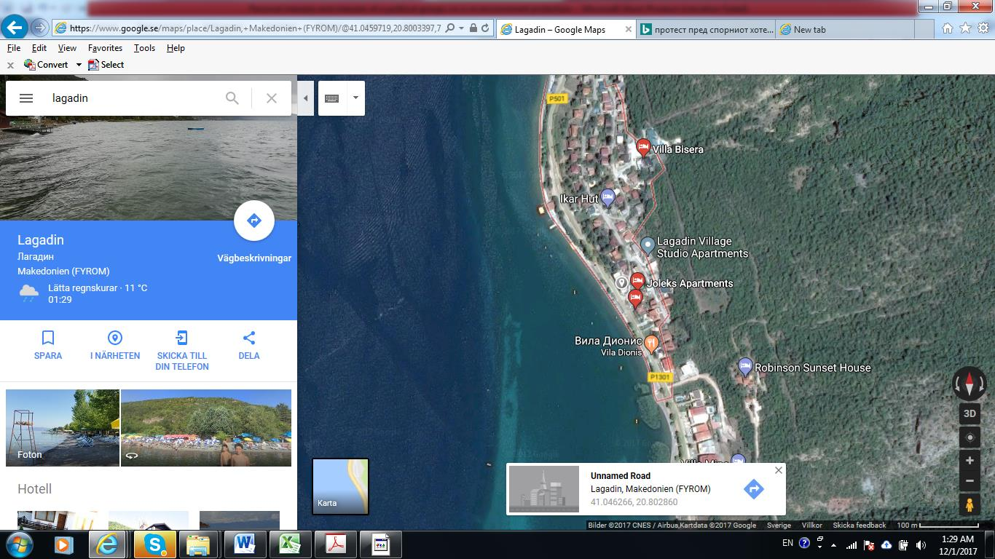
Construction policy in the Municipality of Ohrid. Real needs vs corruption, populism and politics
Picture 1 : Macroposition of the disputed hotel

Slide 30
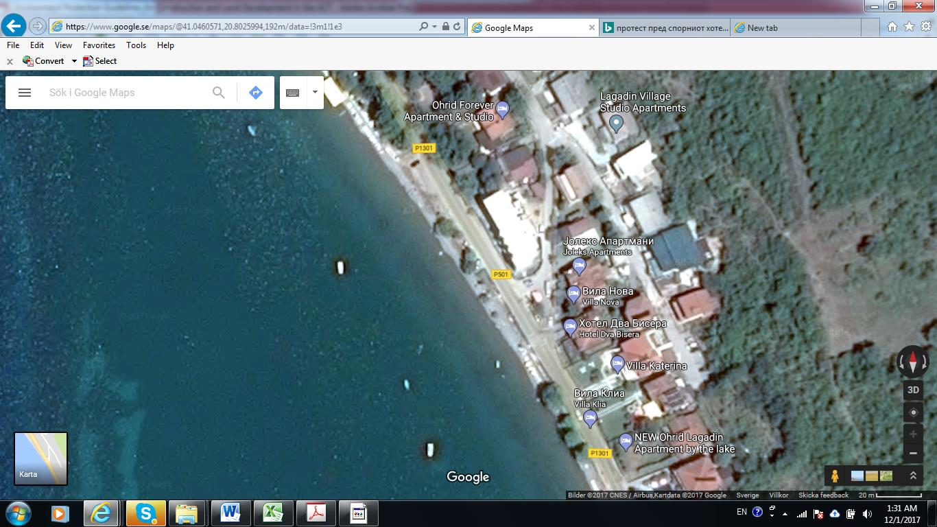
Construction policy in the Municipality of Ohrid. Real needs vs corruption, populism and politics
Picture 1 : Microposition of the disputed hotel

Slide 31
Construction policy in the Municipality of Ohrid. Real needs vs corruption, populism and politics
From the other hand the case is that more than 130 objects were built up near the lake shore or directly at the lake shore (out of which 30 directly at the lake shore) from the lake side managed by Struga and more than 200 objects were built up near the lake shore (out of which around 50 near the lake side) from the lake side managed by the Municipality of Pogradec within the last 15 years;
To be the paradox even bigger in the perimeter of 35 kilometers of shore managed by the Municipality of Ohrid cannot be found more than 1 kilometer of a constructable land that is not belonging to the National Park Galicica that is encompassing the lake (while Galicica holds some 5 kilometers out of 35 that are encompassing the shore).

Slide 32
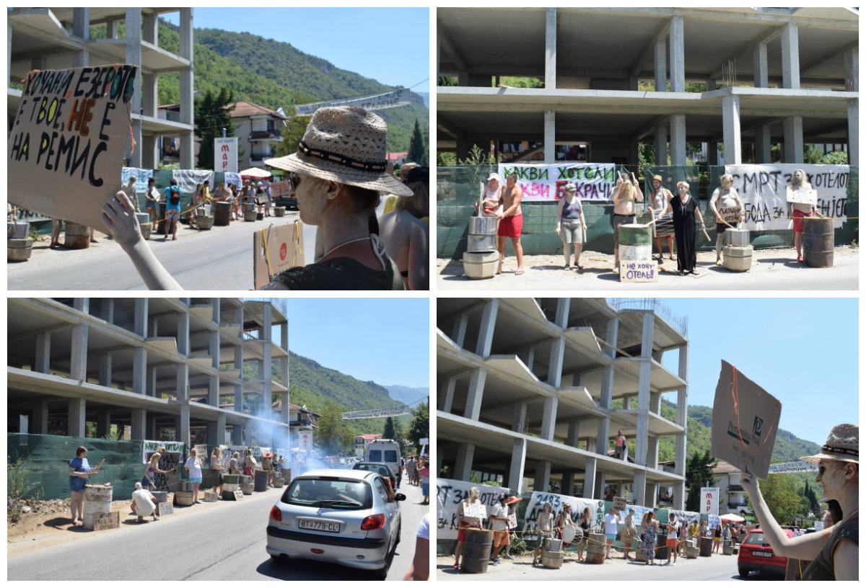

Slide 33
Economic activities near the protected areas and natural resources management
Strictly at the lake side are the villages of Delagozda, Radozda Kalishta, Peshtani, Trpejca and Ljubanista from the Macedonian side and villages Tushemisht, Memelisht, Hudinisht and Lin from the Albanian side;
Survey on the sample of 100 respondants was made in order to find out about their sources of income and monthly income per capita. Since the village of Pestani is largest village bordering the lake shore respondants was undertaken there. Below are the charts :

Slide 34
Economic activities near the protected areas and natural resources management
Chart 1 - Main source of income of the people living in village of Peshtani at shore of the Lake of Ohrid

Slide 35
Economic activities near the protected areas and natural resources management
Chart 2 - Average monthly income per capita in the village of Peshtani at shore of the lake of Ohrid

Slide 36
Economic activities near the protected areas and natural resources management
The poor are very dependent on natural resources. Poor people are compelled to use increasingly natural resources for their survival, which again diminishes the natural resource base;
A lower resource base then reduces the flow of services generated, which worsens poverty. Thus poverty could be interpreted as a cause of high valuation of the present versus the future.

Slide 37
Economic activities near the protected areas and natural resources management
In the area of Galicica national park there are very rare species. For the Park 27 mammal species are described from which 24 are listed in the annexes of the EU habitat directive;
They can be always an attraction for tourists;
Some of the plant species can be used in medical field for the medicine production, food products and other products. For example Onopordum acanthium is used for the production of the liver protection medicines such as Sylimarin, while Geranium robertianum is used for production of medicines in relation with reproductive organs.

Slide 38
Economic activities near the protected areas and natural resources management
Another interesting field where economic activities might be taken into consideration is wood business.
Galicica has half of its 227 square kilometers covered with the tradable and even more needed for personal use wood.
Costs for heating may comprise more than 15% from the poor families budget (and of course if they are paid regularly).

Slide 39
Economic activities near the protected areas and natural resources management
Another issue is that the local citizens from the villages bordering the lake shore also cannot have under the preferable conditions concessions on the shore beaches, that are readvertised every 5 years;
Evenly many of those families owned the same parcels that are in the moment concessioned or owned by the tourism SME’s during the procommunist period.

Slide 40
Economic activities near the protected areas and natural resources management
Many local people had claims on the land that they owned and that was near the Lake or it became protected area under the rule of the park management during the communist period, while currently is operated for the tourist purposes by private they were again not allowed to have land returned and even when they started protesting were imprisoned;
Even in the times of communism once the land was nationalized there were offer for a member or members of family for an employment within public sector;
But nowadays the state was not so “generous” and offered only restitution in financial means with several times underestimated prices;
That caused huge revolt and protest. Anyhow, after the imprisonment of the people identified as protest leaders, the situation was calmed down.

Slide 41
Economic activities near the protected areas and natural resources management
After 20 years under the concession problem with the decrease of the population of salmo letnica (Ohrid troat a kind that is considered the oldest lake water fish specie known in Europe) was not resolved;
And another important issue is that only 24 fisherman are to be employed which is less than 1% of the total fisherman number operating in the area. That is a classic example of not taking into the consideration one of the main success factors for the protected area management.

Slide 42
Economic activities near the protected areas and natural resources management
Another shortcoming is that conditions under which Lake of Ohrid was to be operated by private company were also strange;
For example in the 2012 bid there were only needs for certain amount of money to be paid to the state (33,000 eur), 2.5 millions of pieces of new fish to be inserted into the lake and 24 fisherman to be employed.

Slide 43
Conclusions
Official environment agenda in Macedonia is often misused by the political and business elites and even from people with other personal interests;
One of the key players in this area- Green parties are not present in Macedonia or they are only in trivial manner;
Such situation causes serious defects within policy implementation in this key area. As a consequence from the above media are frequently manipulated in regards with green agenda or they are producing the same representing their owner’s interests.

Slide 44
Conclusions
Construction sector is one of the sectors where usually environmental policy has been misused thus causing great damage to the environmental agenda in the eyes of the public;
For the moment in the developing country such as Macedonia one of the biggest threats to the environmental agenda (together with environmental disinvestment and wrong implementation of regulative ) can be identified as non-inclusion of the economic interests of the poorest parts of population.

